Slide 1
Quarterly Market Review
July 18, 2023

Slide 2
Harry Markowitz: creator of Modern Portfolio Theory (1927-2023)
Notes:
Before we get into the quarterly commentary, we feel that as financial and investment professionals, it is important for us from time to time to pay our respects to individuals that have had enormous impacts on how we invest. Harry Markowitz, the recipient of the 1990 Nobel Prize in Economics and the creator of Modern Portfolio Theory is one of these people. Professor Markowitz passed away on June 22.
Interestingly, Modern Portfolio Theory (MPT) was created in the 1950’s, though we are still using many of the same concepts today. MPT is so important because it fundamentally changed how we think about risk and diversification; it truly was a groundbreaking concept. The theory taught us that instead of focusing on the risk and return of individual securities, we should be focusing on how they interact. Expanding upon the concept of diversification (not putting all your eggs in one basket), MPT highlights how we can build more efficient portfolios. In other words, we can achieve a higher level of return based on a given level of risk, or we need to be comfortable with a higher amount of risk given a level of expected return.

Slide 3
Market Signals
Positive Signals
Reasons for Concern
✔ Inflation still appears to be fading; CPI eased to 3% in June
✔ Economic data continues to suggest the US economy is not currently in a recession
✔ Labor market remains strong even as inflation declines, boosting optimism a soft landing might be possible
✔ Debt ceiling default crisis was averted…for now (expected to be discussed again in early 2025)
✔ Globally, inflation is still stubbornly high; still coming more from services (shelter) vs. goods in the US
✔ With a yield curve still inverted and more potential rate hikes on the horizon, is a recession looming? Are we in a rolling recession?
✔ With a yield curve still inverted and more potential rate hikes on the horizon, is a recession looming? Are we in a rolling recession?
Notes:
As always, we like to take a balanced approach to looking at the global economy and markets, not reacting too positively or negatively to any news.
In particular, the first two bullets in the positive signals column have been the same for three consecutive quarters.
*rolling recession is one that impacts certain sectors of the economy at a time, which can create recession-like conditions for certain economic segments, while escaping being truly defined as a recession.

Slide 4
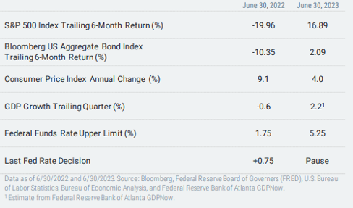
The difference a year makes…
Notes:
Boy, is today’s economic environment different from where we were a year ago. Last June we saw inflation running at 9%, the Fed was still early in their rate hiking cycle and had just executed a 75 bps increase, and bonds were in the midst of earning their worst returns ever for an annual period.
Today, inflation has fallen to 3% (it was 4% at June month end in the chart)(though still above the Fed’s target), consumers and markets have been incredibly resilient, and the Fed just paused their rate increases. Overall, the economic outlook today appears brighter than a year ago.

Slide 5
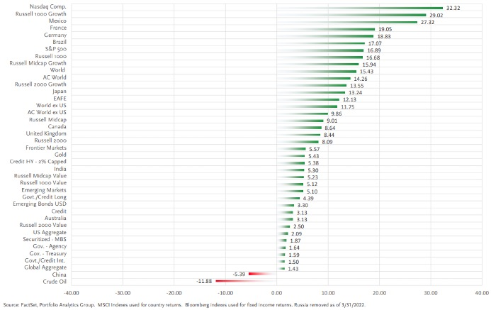
Most markets & asset classes are positive YTD
Source: FactSet, Portfolio Analytics Group, MSCI Indexes used for country returns. Bloomberg indexes used for fixed income returns. Russia removed as of 3/31/2022
Notes:
From a return standpoint, most global stock and bond asset classes are positive on a YTD basis. As we noted already and will dive into a little more in a bit, technology and large cap growth stocks have had the highest returns while only Chinese stocks and the crude oil market have posted negative returns YTD.

Slide 6
It’s all about the Fed’s pace, pause, & pivot
Notes:
Central banks across the globe continue to be between a rock and hard place. For the last few quarters, we have spoken about the three P’s of pace, pause, and pivot. We had noted the Fed’s pace of rate increases has slowed as the last several increases have only been 25 bps. We also noted that there is a lag in the amount of time when these increases occur to when it’s actually seen in the data. And now, after the Fed decided to continue with their 25 bps increases in May, they decided to hit the pause button on another increase in June, ending their streak of increasing rates at ten consecutive meetings. The Fed has made it clear that even though inflation has still moderated, there is still a long way to go to hit their 2% target, that the full impacts of their previous increases may not be fully felt yet, and that investors should prepare for more hikes in the future. In other words, they are pausing for now and we may see more increases coming in future months. Where we stand today, the Fed doesn’t appear to be pivoting anytime soon.
The issue for central banks outside the US is similar. For example, even as the European Central Bank had their 8th straight increase in June, ECB President Christine Lagarde said “we are not thinking about pausing.”
The challenges for central banks remain. As the Fed and other central bankers have repeatedly stated, their main goal is to reduce inflation to more normal levels; and raising interest rates is their tool of choice. However, when they raise interest rates, they also put more pressure on banks, which we know have already been strained.

Slide 7
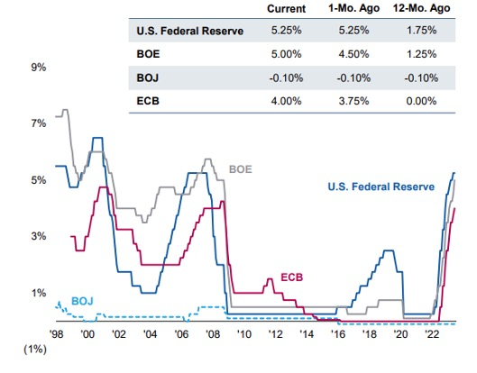
Comparing global central bank policy rates
Source: Eaton Vance, Bloomberg, Factset as of 6/30/23. Data provided for information use only.
Notes:
Inflation has been moderating across most of the rest of the developed world though is still higher than preferred, with year-over year inflation in May of 8.7% in the UK, 6.1% in the Euro area, and 3.4% in Canada. Central banks have acted accordingly, though many are at different stages of their rate hiking cycles. For example, the Bank of England had their 13th straight rate increase, the Canadian Central Bank (not shown) increased rates in June after having been on hold since January 2023, and the Australian Central Bank (not shown) hit the pause button in July after having lifted twelve times since May 2022, but warned more increases were likely coming. In addition, even as the European Central Bank had their 8th straight increase in June, ECB President Christine Lagarde said “we are not thinking about pausing.”
The challenges for central banks remain. As the Fed and other central bankers have repeatedly stated, their main goal is to reduce inflation to more normal levels; and raising interest rates is their tool of choice. However, when they raise interest rates, they also put more pressure on banks, which we know have already been strained.

Slide 8
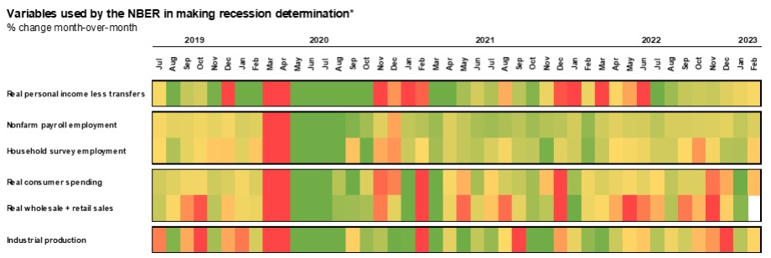
Recession alarms still not sounding off
Source: Bureau of Economic Analysis, Bureau of Labor Statistics, Census Bureau, Citigroup, NBER, J.P. Morgan Asset Management. Heatmap shading reflects 10 years of data, with green and red reflecting a range of +/- 0.5 standard deviations from a baseline of 0% monthly growth. *The NBER’s definition of a recession involves a significant decline in economic activity that is spread across the economy and lasts more than a few months. Specifically, they consider real personal income less transfers, nonfarm payroll employment, employment as measured by the household survey, real personal consumption expenditures, wholesale-retail sales adjusted for price changes and industrial production. There is no fixed rule about which measures contribute to the process or how they are weighted, but the committee notes that “in recent decades, the two measures we have put the most weight on are real personal income less transfers and nonfarm payroll employment.” Guide to the Markets – U.S. Data are as of March 31, 2023.
Notes:
For almost the entirety of the last year, economists and pundits have been warning of a recession. However, when you look at the variables used to determine a recession, the evidence shows that we are not currently in one. Similarly, as we heard one recent economist suggest, as 68% of GDP comes from consumption, it’s hard to have a recession when consumers are still spending.

Slide 9
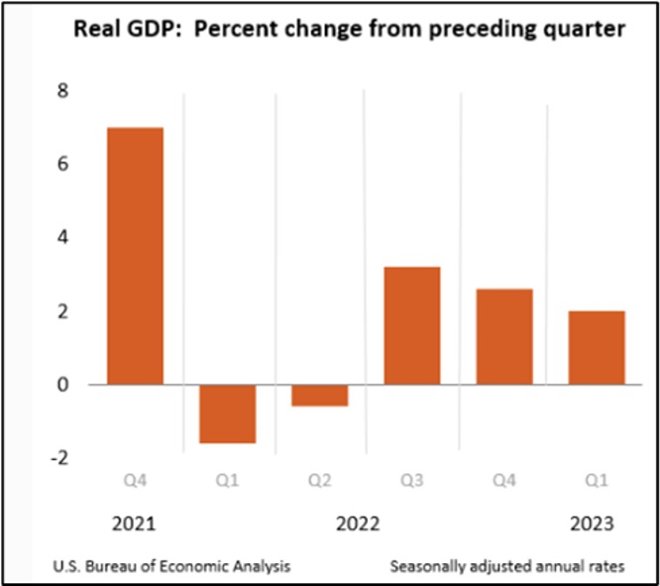
Back-of-the-envelope recession calculation
Notes:
The shorthand definition of recession is 2 or more consecutive quarters of declining GDP. Based on this, we can see that economic growth has been slowing since the middle of last year, but the economy has not been shrinking. Therefore, even if you use the back-of-the-envelope calculation for a recession, this simple methodology also shows that we are clearly not in a recession (next GDP data release is July 27, 2023).

Slide 10
Fed is going for a soft landing
Notes:
In the end, the Fed is working towards what is referred to as a soft landing, which essentially occurs when they achieve their dual mandate of full employment and stable prices without causing a recession. Many economists, however, are concerned about a hard landing, which is when the Fed pushes too high with rates, slowing growth, leading to a recession and/or higher unemployment. Ultimately, inflation is still too high today, and the Fed will continue working to bring it lower. But the longer we avoid a hard landing, the possibility of a soft landing increases.

Slide 11
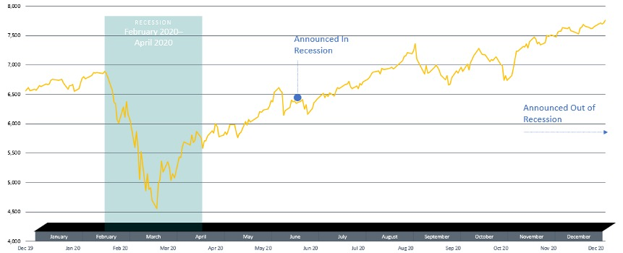
Don’t let market headlines drive your decisions
S&P 500 Total Return Index daily performance, January 2020-December 2020
Source: Dimensional Fund Advisors. Performance data represents past performance and does not predict future performance. Performance does not reflect the expenses associated with the management of an actual portfolio. S&P data © 2022 S&P Dow Jones Indices LLC, a division of S&P Global. All rights reserved. Indices not available for direct investment therefore, their performance does not reflect the expenses associated with the management of an actual portfolio.
Notes:
This slide is a perfect example of two concepts. One is that the economy (via measuring recessions) is not the market. The other concept is that market timing doesn’t really work, especially if you use economic indicators or headlines to drive your investment approach. As the picture shows, there was an official recession from February 2020 to April 2020. However, it was not announced by the NBER that we were actually in recession until June 2020 (2 months after the recession ended) and it wasn’t announced that we ended the recession until July 2021. Look at the returns you would have missed out on if you unsuccessfully timed these markets based on headlines.

Slide 12
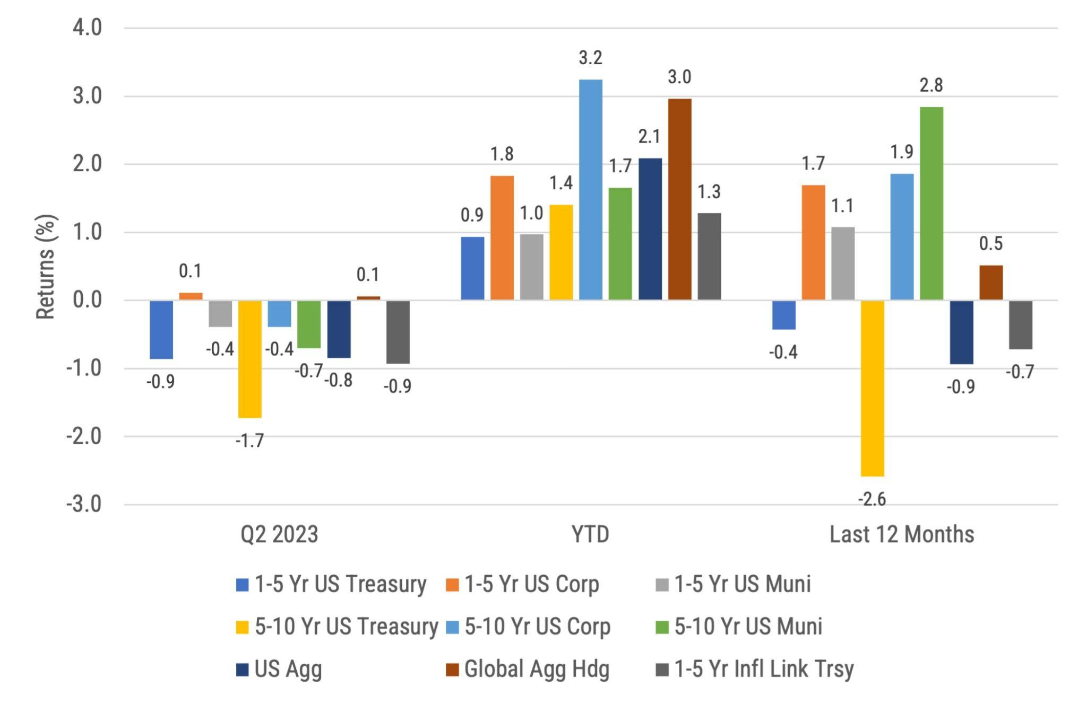
Global fixed income returns
Source: Morningstar, Bloomberg and ICE BofA ML benchmarks shown. Past performance is not indicative of future results.
Notes:
The fixed income indexes we follow were mainly negative for the quarter with the exception of 1–5-year US Corporates (+0.1) and Global Aggregate (hedged USD) bonds (0.1%). All of the fixed income indexes were positive on a YTD basis.

Slide 13
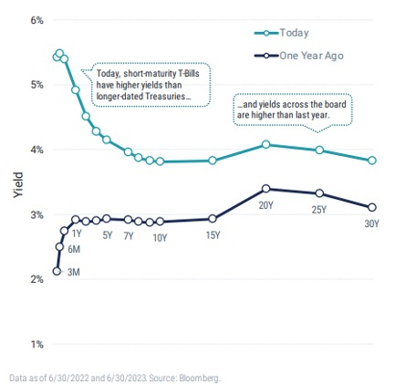
A highly inverted Treasury curve
Source: Bloomberg
Notes:
Yields rose across the entirety of the yield curve over the quarter as the stress of the banking sector moved further away in the rear-view mirror, and as signs of continued economic strength and resilience appear. In fact, the yield curve inversion has been exacerbated as Treasury yields increased more on the short end vs. the intermediate and long-term parts of the yield curve. When you look at the yield curve on a YTD basis, 3-month Treasury yields have increased by 101 bps while 30 year Treasury yields have actually decreased by 12 bps. What is this telling us? The short answer is that with the Fed suggesting there may be two more interest rate hikes this year, we should expect the yield curve to stay inverted with this tighter monetary policy. Investors on the long end of curve are still somewhat expecting the Fed will eventually ease, even though the Fed has not given any indication that will happen anytime soon, so yields at the long end remain largely unchanged from year end.

Slide 14
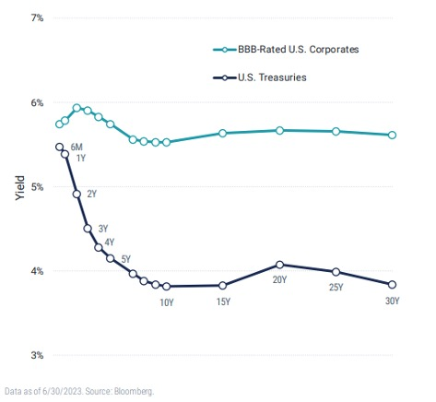
Different yield curves tell different stories
Source: Bloomberg
Notes:
Remember, too, that the focus of the last slide was Treasury bonds, but other bonds have their own yield curves that have different shapes and move for different economic reasons. This chart shows the US Treasury yield curve vs. that of BBB-rated US Corporate bonds. A few things stand out. For one, as we should expect because they are riskier, corporate bonds offer a higher yield vs. their Treasury counterparts. Second, unlike the highly inverted Treasury curve, the corporate curve is significantly flatter, meaning intermediate corporate bonds are offering much more yield vs. intermediate Treasuries. At the end of the day, we recommend owning some intermediate term Treasuries as a hedge to equity returns, while corporate bonds can be owned to generate more fixed income return while still maintaining a high average credit quality. To come full circle, Harry Markowitz taught us to not focus on individual security risk, but how securities interact with each other within a total portfolio.

Slide 15
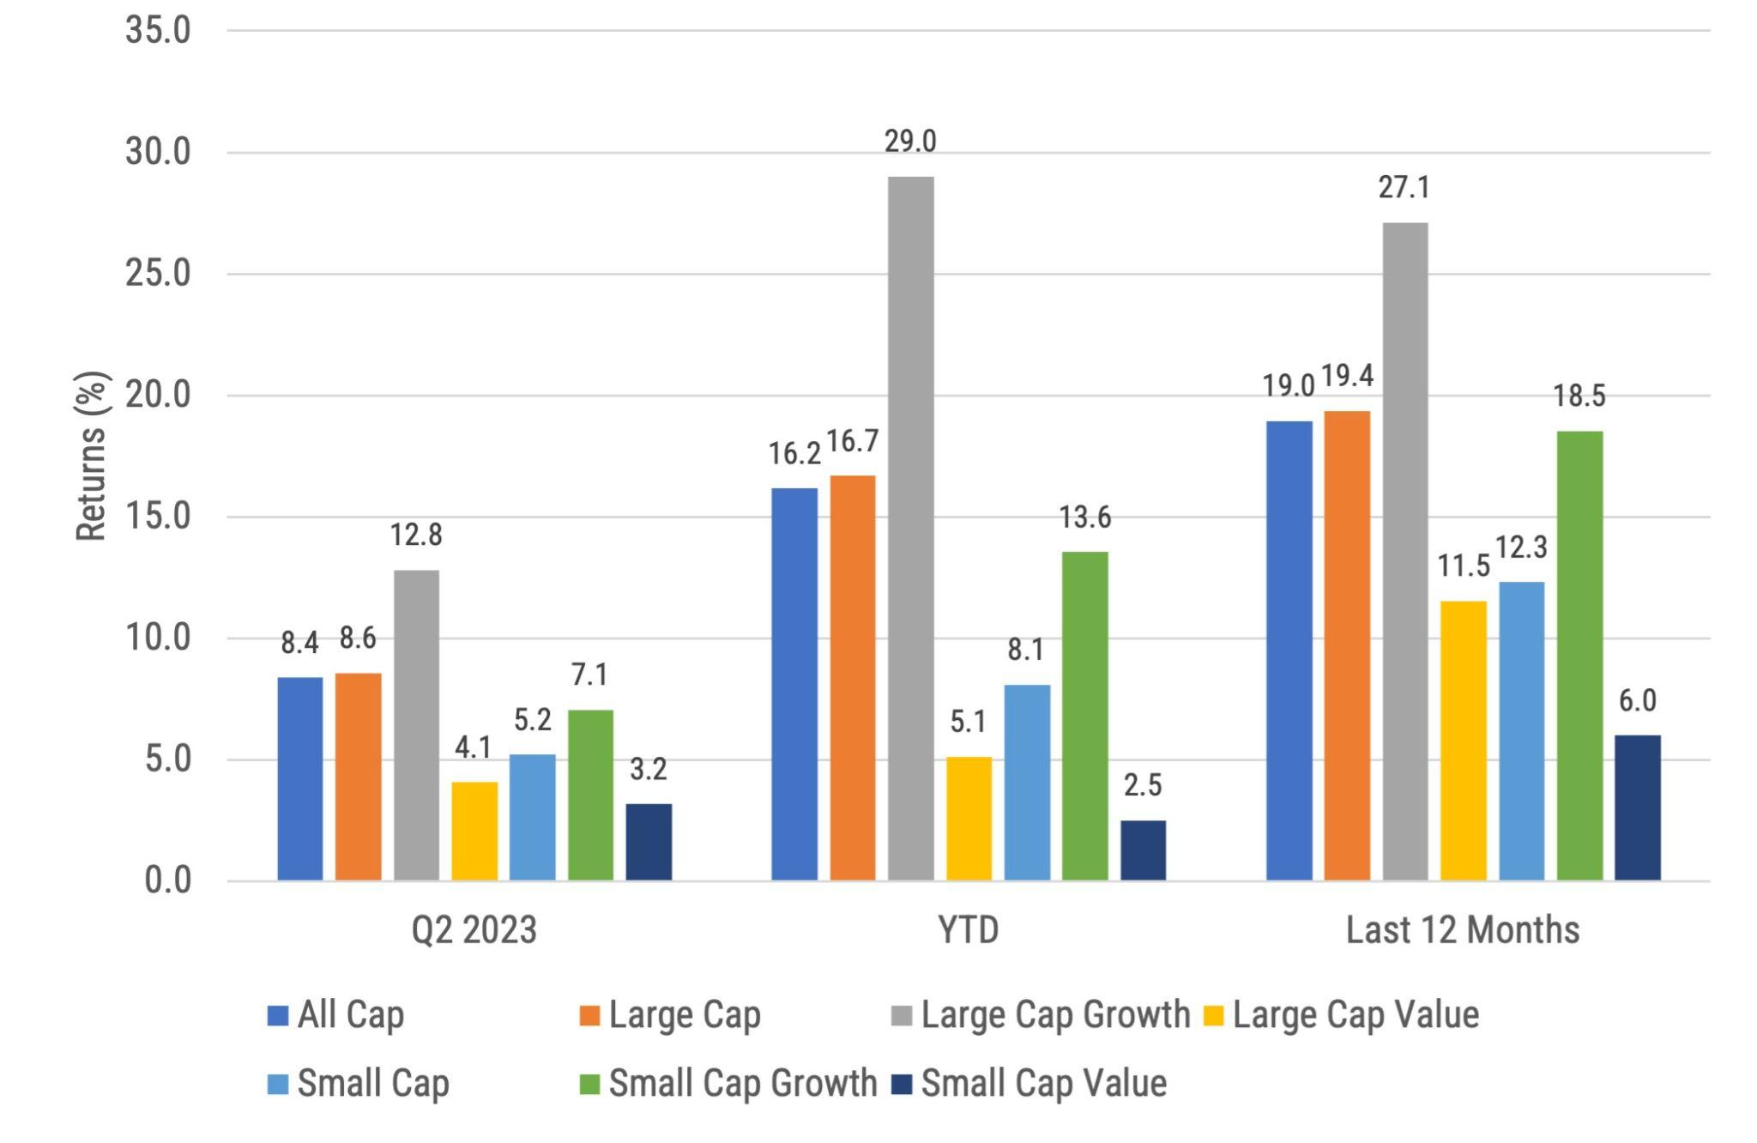
US Equity Returns by size and style
Source: Morningstar, Russell benchmarks shown. Past performance is not indicative of future results.
Notes:
For the first time in many quarters, we are able to report positive US equity returns across the benchmarks we follow over the last quarter, on a YTD basis, and for the last 12 months, with large cap growth stocks leading over those time periods. Partially as a result, the S&P 500 ended June at its highest point through the first six months of the year.

Slide 16
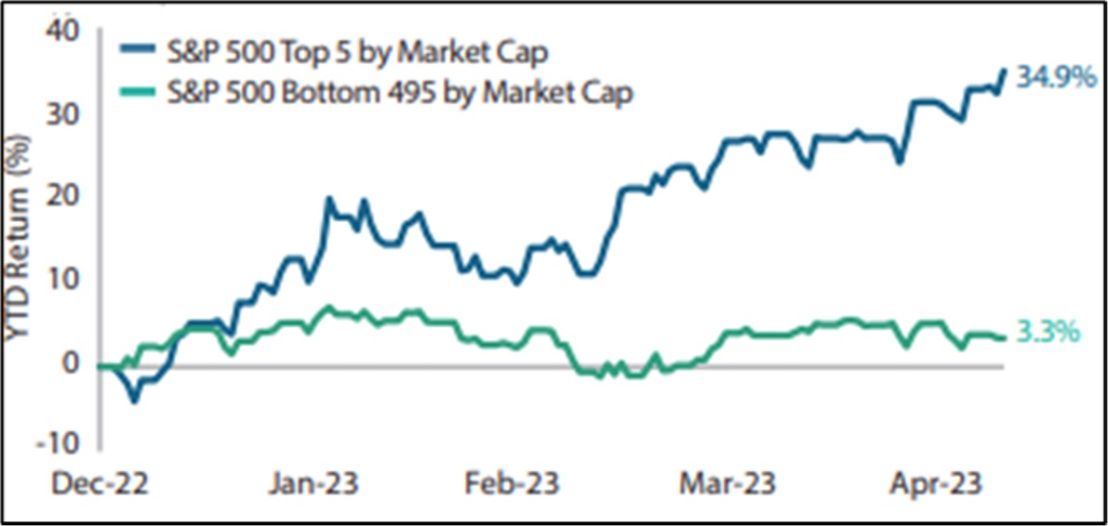
Top 5 stocks driving US stock returns
Source: T Rowe Price, past performance is not indicative of future results. Returns reference S&P 500 Index. As of May 31, 2023
Notes:
This chart shows the rally in the S&P 500 has been very narrow. Specifically, on a YTD basis through May, the top 5 stocks in the S&P 500 have combined to deliver a 34.9% return while the other 495 remaining stocks achieved a much lower 3.3%. This is important because broader market rallies have generally been more sustainable and are considered healthier vs. narrow one.

Slide 17
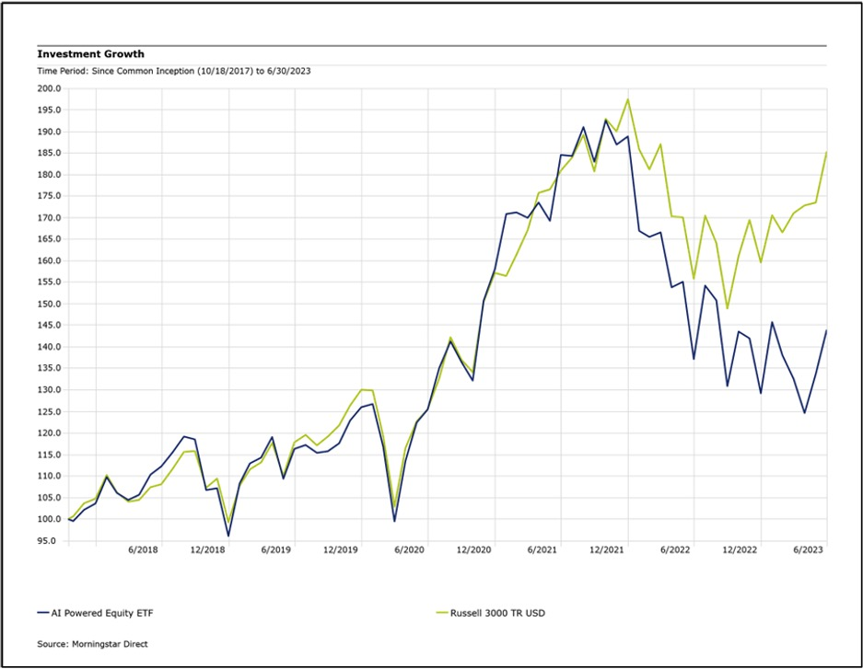
Has AI produced superior returns?
Source: Morningstar Direct .
Notes:
Within the tech sector, AI has been a hot topic over the quarter with functionality like ChatGPT making its way into our lexicon. With all the buzz about AI, it’s not surprising that folks are trying to find ways to invest in AI. Before getting too excited that we have some fantastic ideas on how to do this, remember, AI has been around in one form or another for many years. Also remember that markets are incredibly complex, so we wouldn’t bet too much today on AI being able to outsmart the market on a consistent basis.
To show you just how difficult it is to consistently outperform the market using AI, we ran a comparison of the Russell 3000 Index, a broad US equity index, vs. AIEQ, the first actively managed ETF to fully utilize artificial intelligence as a method for stock selection. Per its own website, it claims its AI powered ETF sing IBM Watson equals a team of 1,000 research analysts, traders, and quants working around the clock. It also analyzes “millions of data points across news, social media, industry and analyst reports, financial statements on over 6,000 companies, technical, macro, market data and more.” Surely something this complex can easily outperform a simple and broad based index like the Russell 3000? Not so fast. As this chart shows, since the inception of AIEQ in October 2017 through June 2023, the Russell 3000 has outperformed the AI-powered ETF, returning 11.4% vs. 6.7% on an annualized basis. Overall, while AI might be able to digest information, we are not convinced it will be able to predict the future, nor how markets will respond, so we caution against trying to invest with an AI focus.

Slide 18
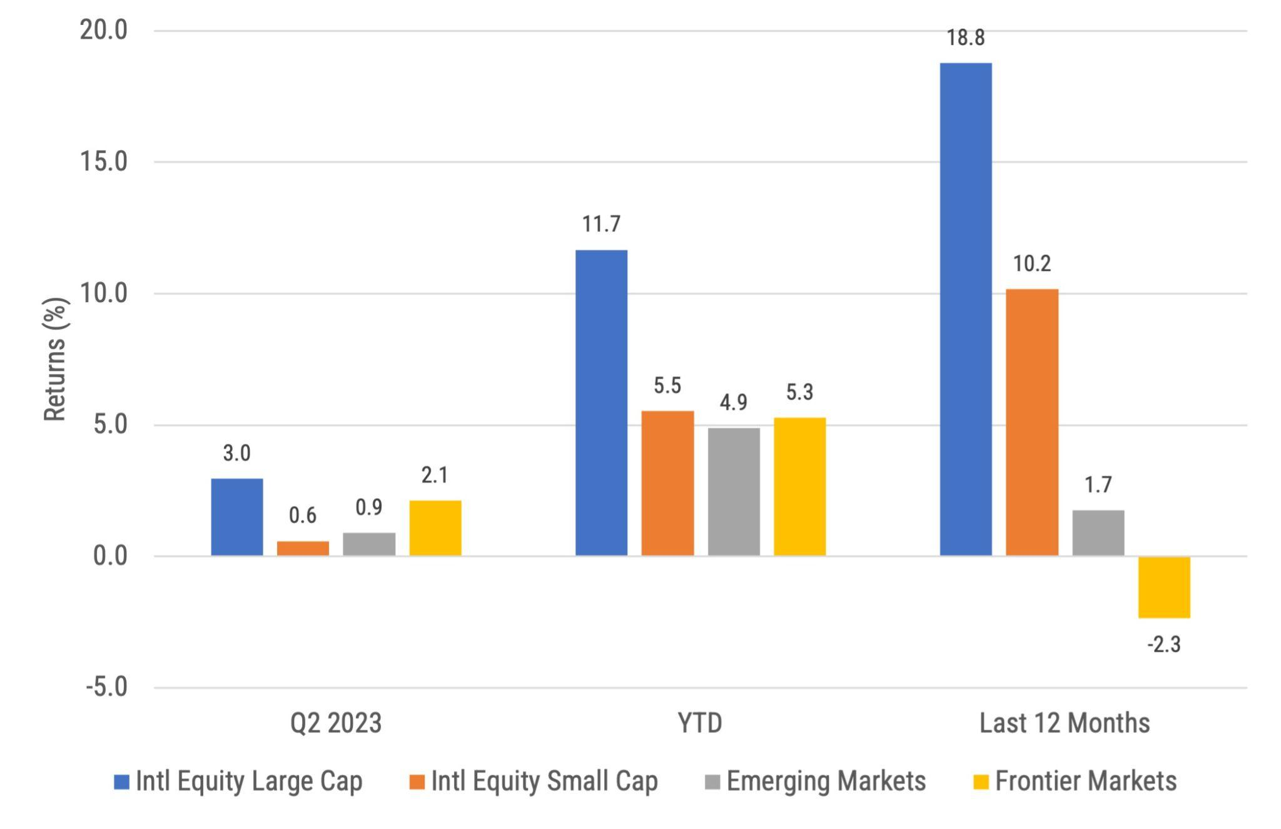
International developed, emerging and frontier equity returns
Source: Morningstar, MSCI benchmark shown. Past performance is not indicative of future results.
Notes:
All international indexes we track were positive over the last quarter and on a YTD basis, though they underperformed their US counterparts.
In fact, there were no developed countries that outperformed the US markets over the 2nd quarter. Italy (7.3%), Japan (5.4%), and Spain (5.2%) had the highest developed non-US country returns.
As we have previously noted, China remains roughly 1/3 of emerging markets, so its performance has a meaningful impact on the overall results of EM indexes. For the quarter, China was unfortunately one of the worst returning countries, falling -9.9%, and that overwhelmed the positive outcomes in places like Greece (24.9%), Hungary (24.4%), Poland (23.5%) and Brazil (21.9%).
Source: Dimensional Fund Advisors, Country returns are the country component indices of the MSCI All Country World IMI index
Finally, the rising US Dollar relative to a basket of foreign currencies was another factor in the quarterly underperformance of non-US stocks relative to US stocks.

Slide 19
Dollar strength is good for US consumers but bad for owners of non-US investments
Dollar strength is good for US consumers but bad for owners of non-US investments
Source: Wall Street Journal as July 3, 2023. Past performance is not indicative of future results.
Notes:
WSJ’s Dollar Index (BUXX) represents the value of the USD relative to a basket of 16 foreign currencies.
A rising dollar is generally good for US consumers as it makes foreign goods cheaper to purchase, but bad for owners of non-dollar-denominated assets, such as foreign stocks. Said differently, a strong dollar hurts international returns. A strong dollar also hurts US exports and therefore can also negatively impact US production and employment.
The top chart shows the movement over the last 20 years for longer term trends while the bottom chart shows the last 3 months where the dollar fell over the quarter. The top chart shows the dollar is currently still stronger than most other time since the inception of this WSJ Dollar Index. Having the US Dollar continue to decline further would be a catalyst for non-US equity returns to be stronger vs. US equities.
The bottom chart shows an increase in the dollar overall for the quarter, though it ended the quarter below its high at the end of May.

Slide 20
Maintain your focus on what really matters
✔ Financial planning is a process, not an endpoint
✔ Concentrate on long-term goals and objectives
✔ Focus on reaching goals, not on beating benchmarks
✔ Maintain a disciplined approach, in good and bad markets
✔ Invest broadly and globally; asset allocation is key
✔ Reduce investment and tax costs where possible
✔ Rebalance as necessary
Notes:
Do investments matter? Of course they do; however it is not investments alone that will help you achieve your goals. Maintaining a focus on these bullet points is what really matters in helping you achieve your goals.

Slide 21
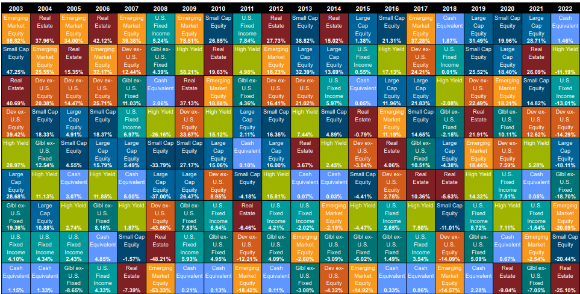
Diversification matters
Source: Callan, Large Cap Equity = S&P 500, Small Cap Equity = Russell 2000, Developed ex-US Equity = MSCI World ex-USA, Emerging Markets Equity = MSCI Emerging Markets, US FI = Bloomberg US Aggregate, High Yield = Bloomberg Corp High Yield, Global ex-US FI = Bloomberg Global Aggregate ex-US, Real Estate = FTSE EPRA Nareit Developed REIT Index, Cash Equivalent = 90 day T-bill
Notes:
In Q3 2020, this chart was changed to the Callan chart, which is only updated annually. It was changed to this chart to show a greater number of annual periods.
The chart is updated during the first quarter each year so it will still be the previous years chart in the Q4 version each year.
Note that in 2021, the chart started the inclusion of hedge funds.

Slide 22
Questions?

Slide 23
Important Dates
Stop by and see us at XYPN LIVE! September 19th-21st - Grab your pass
Quarterly Market Review: Tuesday, October 17th 9am PT / 12pm ET
Click here to Register

Slide 24
Disclosures
This information is not intended to be used as the primary basis for investment decisions, nor should it be construed as advice designed to meet the particular needs of an individual investor. Investing in mutual funds, ETFs, and other equity and debt securities involves risk, including loss of principal. An investor should consider a portfolio’s investment objectives, risks, and expenses carefully before investing. Please read any applicable funds’ prospectus carefully before investing. Investors cannot invest directly in an index. Indexes are unmanaged and reflect reinvested dividends and/or distributions, but do not reflect sales charges, commissions, expenses or taxes.
XYIS constructs and manages investment models (“Model Portfolios”) through a technology solution. The Model Portfolios can be used by independent registered investment advisers (“RIAs”) that are members of XYPN, but not affiliated with the XYIS. XYIS manages its Model Portfolios on a discretionary basis primarily by allocating assets among various mutual funds and exchange-traded funds (“ETFs”). XYIS may also allocate assets in individual debt and equity securities. While XYIS will select mutual funds and ETFs for the Model Portfolios, provide guidance and information about the Model Portfolios to RIAs, RIAs are responsible for choosing the specific model and allocation for each of their Clients.

