Slide 1
2023 Q4
Quarterly Market Review
Presented By: Mario Nardone

Slide 2
Positive Signals
Reasons for Concern
It was a strong year for investor returns, even with all the noise, highlighting how hard it is to time the markets.
Inflation measures continue to recede from their recent peaks; hope for a soft landing abounds.
There is more “income” from fixed income than there has been in years.
US large cap stocks’ return is being driven by only a small number of stocks (the Magnificent 7).
Many geopolitical risks lurk in the background (wars in the Ukraine and Middle East, possibilities of a US government shutdown, and 2024 is a presidential election year in the US).
It’s still possible that inflation can increase, causing the Fed to raise rates again.
Notes:
As always, we like to take a balanced approach to looking at the global economy and markets, not reacting too positively or negatively to any news.

Slide 3
2023 by the numbers
0 recessions in 2023 (experts anticipated there would be one during 2023).
1 rating agency (out of three; Moody’s) still has the US as a AAA credit rating.
22.2% was the return for global stocks (MSCI ACWI), highlighting a strong year.
26.3% was the return of the S&P 500 in 2023. The Magnificent 7 jumped by 76.3% while the rest of the stocks gained just 13.7%.
Notes:
Congress came to a compromise at the end of September to avoid a government shutdown, at least for now, as the bill just signed only funds the government through November 17, 2023. Should investors be concerned about a shutdown having a significant negative impact on the economy and markets? No, if history is any indication. Overall, there have been 21 government shutdowns since 1976. and one could classify the mixed market results as noise. In summary, of the 21 previous shutdowns, 11 saw the S&P move in a positive direction during the shutdown with nine experiencing declines (one shutdown occurred overnight, when markets were closed, so there was no market impact).

Slide 4
2023 by the numbers (continued)
5.25% - 5.50% was the Fed’s policy rate reached in July as they worked to tame inflation, the highest level since 2001. It is the same level at year-end.
3.1% was the November 2023 headline CPI figure, having fallen since it hit 9% during the summer of 2022, though still above the Fed’s 2% target.
4.98% is where the US 10 Year Treasury closed at on 10/19/2023. The last time it ended that high was 7/19/2007, when it closed at 5.04%. 10 Year Treasuries rallied at the end of the year, closing at 3.88%.

Slide 5
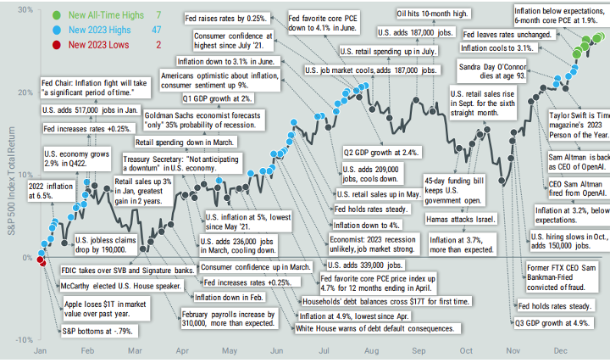
Headlines of 2023
Source: Factset, Avantis Investors, data from 1/1/2023 – 12/29/2023. Past performance is no guarantee of future results.
Notes:
On the last slide we mentioned the 2023 return for the S&P 500 was 26.3%. But as this slide shows, it wasn’t a smooth ride to get there.
Through the year, we can see how the Fed’s pace of rate increases slowed until they paused later in the year, we can see how even in the second quarter the economic forecasts for Goldman Sachs still suggested a 35% chance of a recession, all the while the S&P experienced highs and lows throughout various parts of the year.

Slide 6
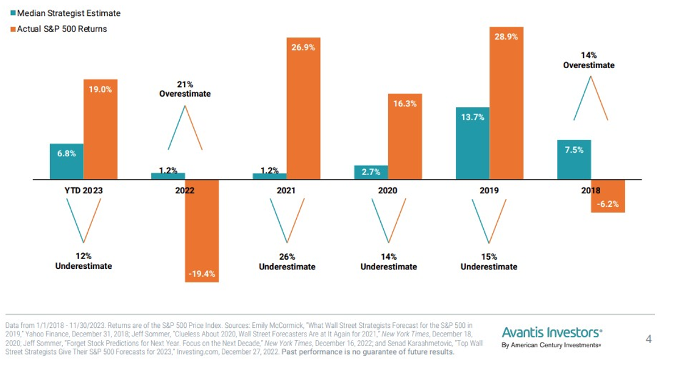
Don’t follow the forecasts
Notes:
This chart shows the consensus estimates from industry strategy forecasts vs actual S&P 500 returns through November 2023 and the preceding 5 years. The results are not favorable for forecasters. For the five completed years, the estimation error ranged from 26% too low to 21% too high. On average, the median annual estimate was off by about 18%, nearly double the index’s long-term average annual return.

Slide 7
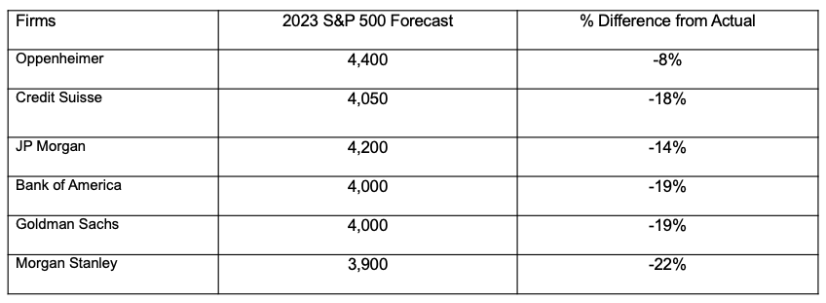
Forecaster’s crystal ball is broken.
Source: https://www.marketwatch.com/story/wall-streets-stock-market-forecasts-for-2022-were-off-by-the-widest-margin-since-2008-will-next-year-be-any-different-11671583416
Yahoo! Finance The S&P 500 ended the year at 4769.83. Past performance is no guarantee future results.
Notes:
More specifically this chart looks at the exact same institutions we reviewed last year at this time, so this list had no cherry-picking. We wanted to update their 2023 forecasts with what actually occurred.
Each of the firms shown had lower forecasts vs. what actually occurred, from being off by 8% to being off by 22% In other words, while forecasting makes for interesting debate and conversation, we wouldn’t suggest basing your investment strategy off of forecasts.

Slide 8
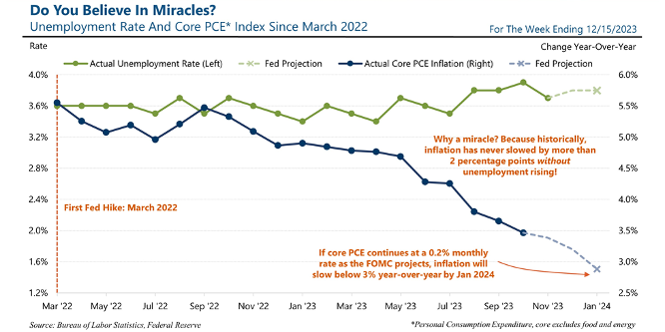
Source: Bureau of Labor Statistics, Federal Resesrve
Notes:
Speaking about how wrong forecasts can be, there was broad consensus at the end of 2022 that there would be a recession in 2023, a recession that never occurred.
In fact, 2023 was somewhat of an odd year in that we witnessed a continued decrease in the inflation rate without a corresponding increase in unemployment, an event that Fed Chair Jerome Powell referred to as “a surprise to just about everybody.”

Slide 9
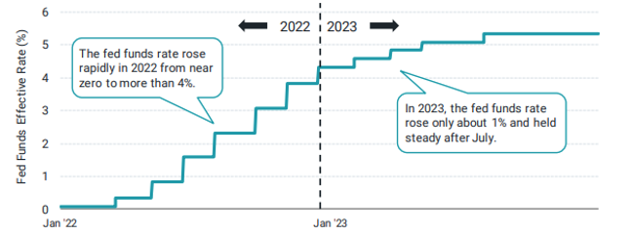
It’s all about the Fed’s pace, pause, & pivot
Source: FRED data from 1/1/2022 – 12/31/2023
Notes:
Speaking about inflation, for at least the last year we have spoken about the three P’s of pace, pause, and pivot. We all remember what happened in 2022. Looking back to the 2nd quarter of 2023, we saw the Fed implement their last rate increase, moving rates up by 0.25% in July. Since then, the Fed has hit the pause button as the Fed Funds rate remains at the 5.25-5.5% range it set over the summer.
The Fed says they will continue to be data dependent on making any future changes as inflation is still higher than desired, and with a labor market that remains tight. They have continued to promote the idea that even though inflation has moderated from last year’s highs, there is still a long way to go to hit their 2% target, and that there are no guarantees what the future will bring. In other words, it could be a while before the Fed pivots, and starts lowering the Fed Funds rate.

Slide 10
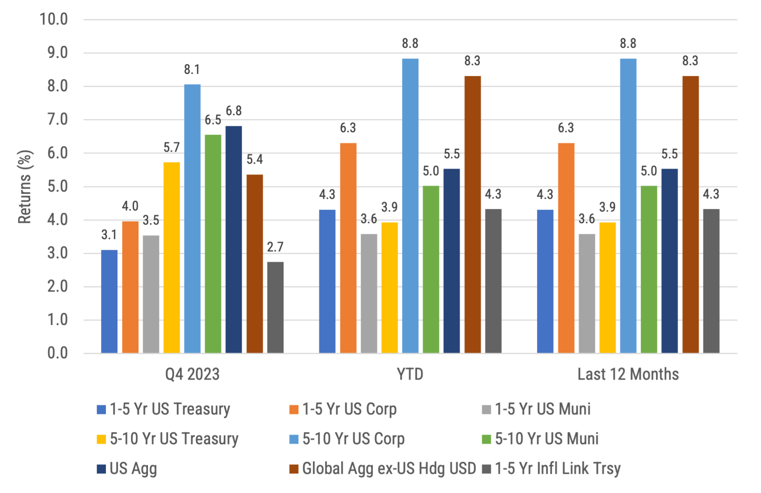
Global Bond Returns
Source: Morningstar, Bloomberg and ICE BofA ML benchmarks shown. Past performance is not indicative of future results.
Notes:
There was a significant decline in US bond yields during the 4th quarter that drove returns. In particular, the intermediate and long parts of the curve saw their yields fall more dramatically vs. the shorter end of the curve.
And if you look at Q4 returns, they were a major driver of 2023 returns overall. For example, 5-10 yr corporates had a Q4 return of 8.1% but a return overall for 2023 of 8.8%.
Global bonds ex-US (hedged USD) also had a strong 2023 with gains of 8.3%.

Slide 11
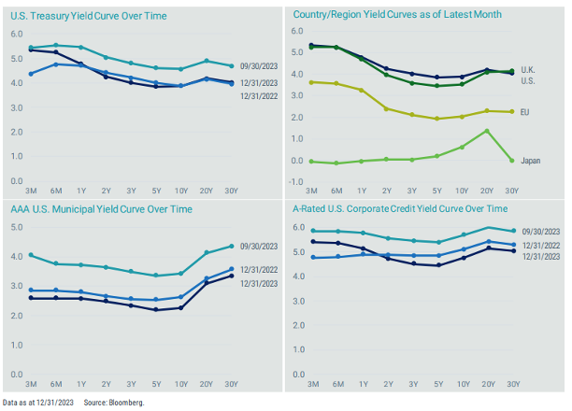
Stories from global yield curves
Source: Bloomberg
Notes:
This is a set of charts we often include because there are several good stories to tell.
For example, if you look at the chart on the top left, it tells a few good stories. For one, you can see the rate levels we are at today vs. the near zero levels of just a few short years ago. This is important for investors as they can now receive actual income on their fixed income (bonds). Also, you can see how the curve for 12/31/2023 is below that of the one for 9/30/2023, highlighting how strong the bond rally was over the last quarter, generating strong returns across Treasuries. Plus, while the curve from 12/31/2023 is very similar to the curve from the previous year, it doesn’t show how much change actually occurred throughout the year. And finally, the curve is still inverted, meaning shorter term yields are higher vs. longer term yields. However, we would caution about having too much in cash, as reinvestment risk could be an issue.
Separately, if you look at the chart on the top right, you can see how the various country curves are differently shaped and at different levels of rates, highlighting the diversification opportunities that exist by investing globally in bonds too.

Slide 12
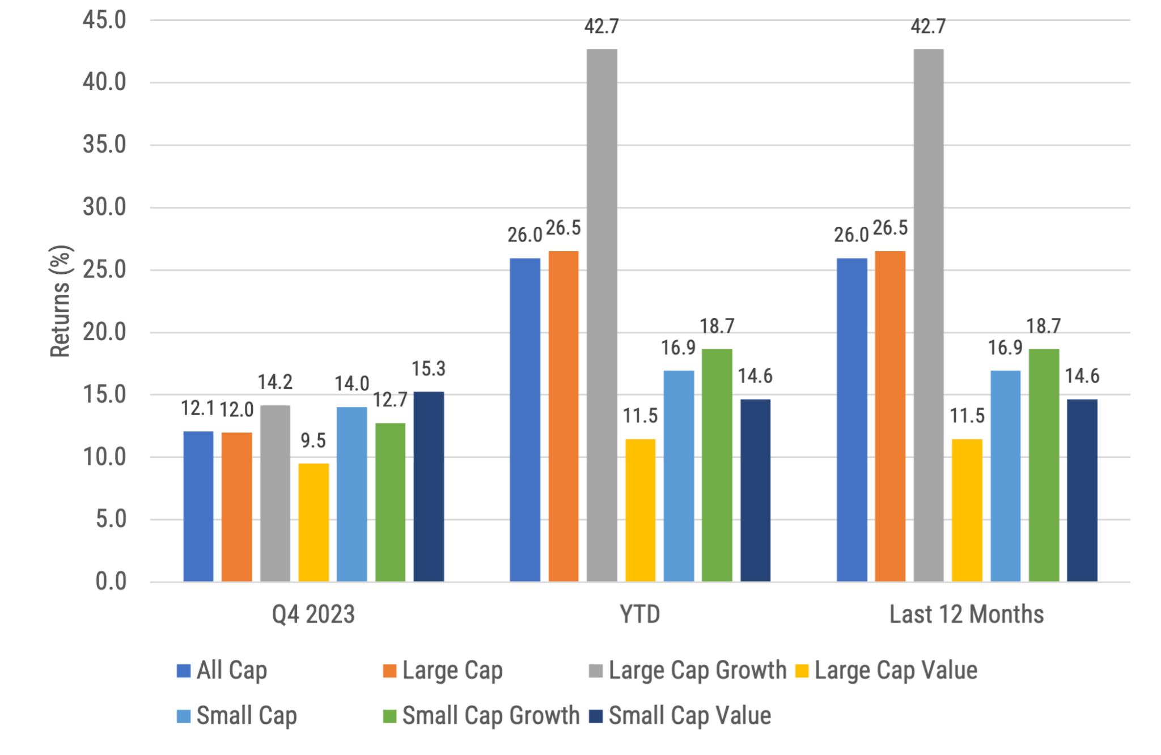
US Stock Returns by size and style
Source: Morningstar, Russell benchmarks shown. Past performance is not indicative of future results.
Notes:
All US stock indexes had strong gains for the quarter and the year.
Large growth stocks have the highest annual return (+42.7%), but returns are only being driven by a few stocks.

Slide 13
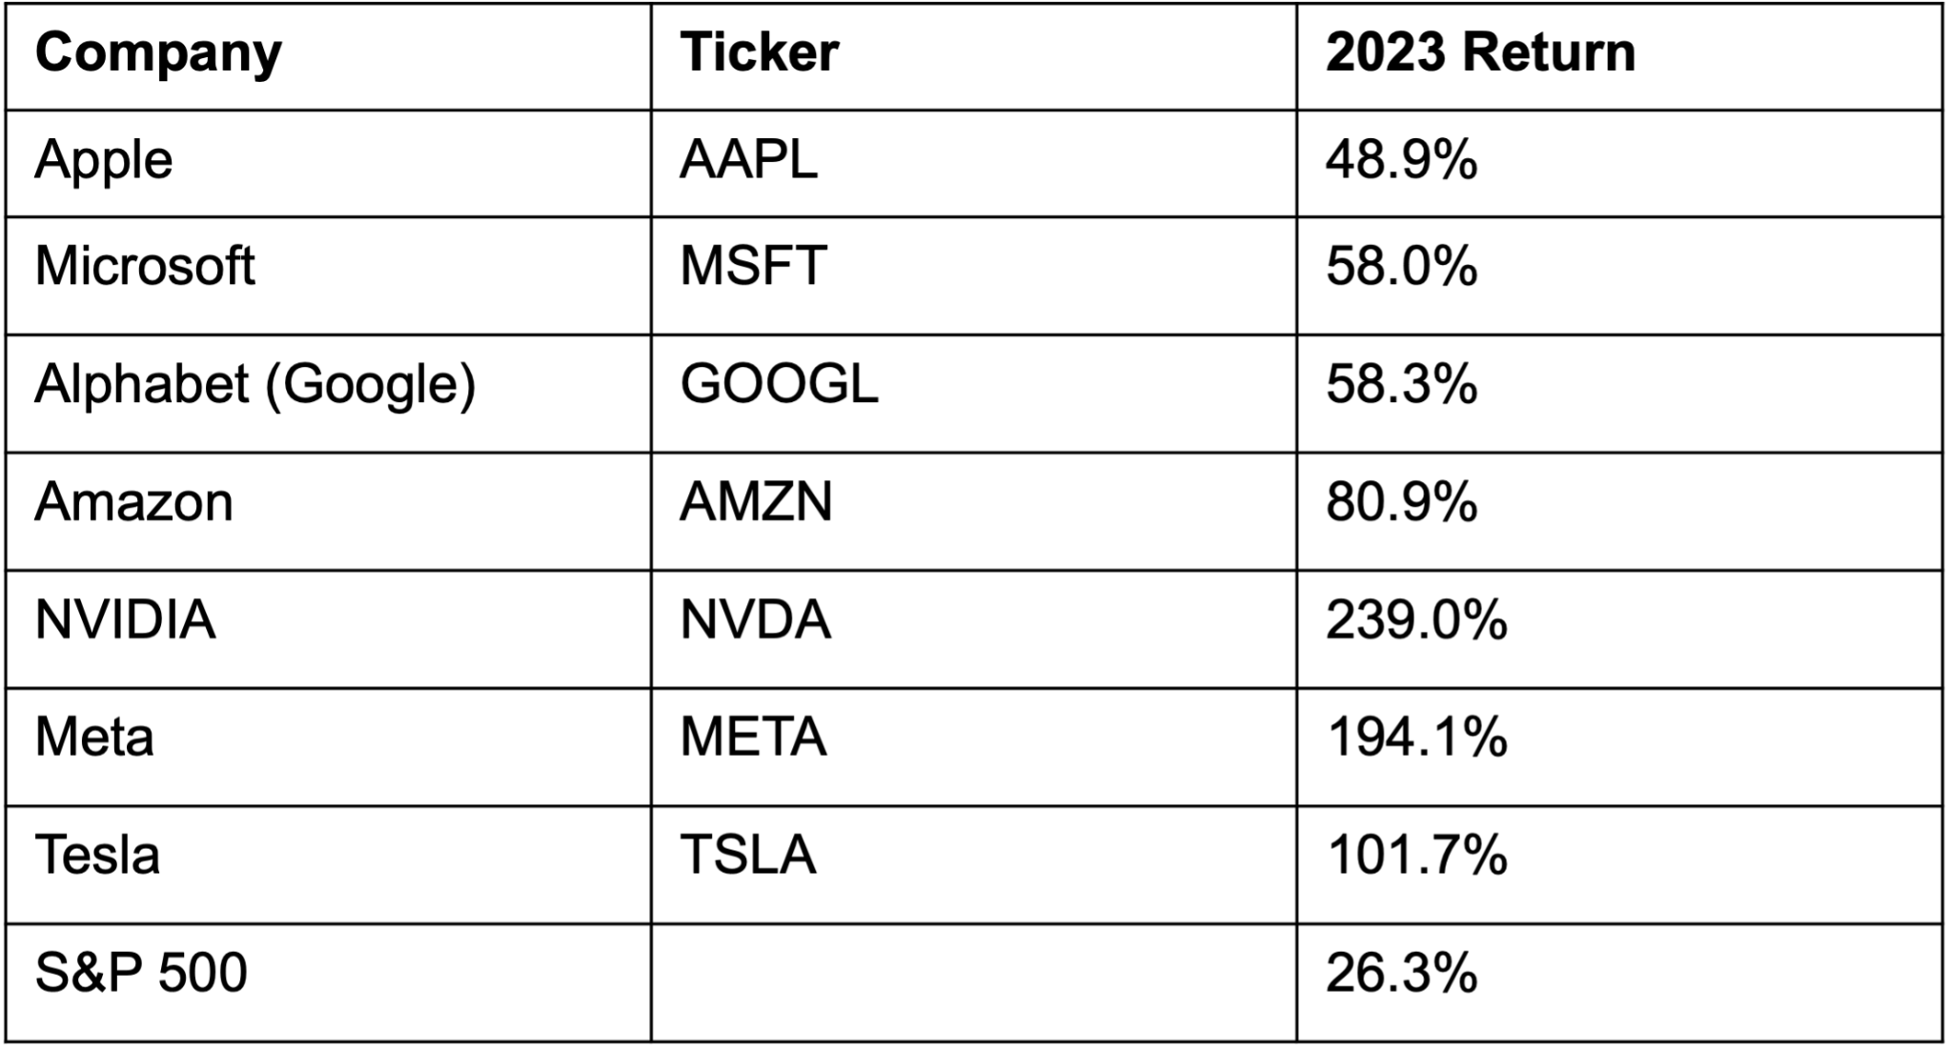
The Magnificent 7 Drove the S&P 500
Source: Morningstar. Past performance is no guarantee of future results.
Notes:
The S&P 500 had a stellar 2023 return of 26.3%. However, the majority of that return came from just 7 stocks, now known as the Magnificent 7 as they had a ridiculously strong 2023 with a combined return of 76.3%, compared to the 13.7% return of the remaining stocks in the S&P 500. This is important because when investors see the return of the S&P 500, they should know it is being driven by just a few names and not the broad market in general. Plus, when a stock rally is broad, the overall health of the market is considered to be better.

Slide 14
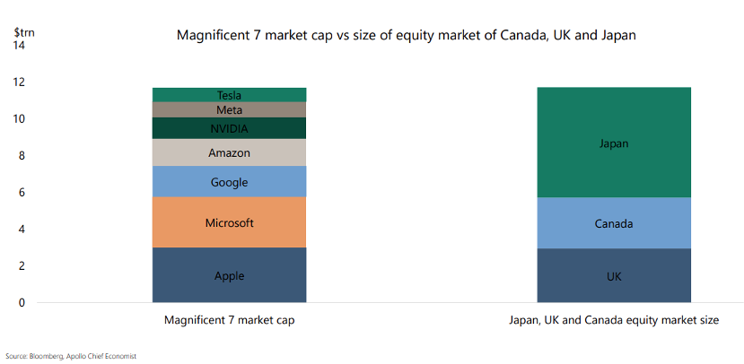
Just how big are the magnificent 7?
Source: Bloomberg, Apollo Chief Economist
Notes:
Just how big are the Magnificent Seven today? They are so large that their combined market cap is roughly the same size as the equity markets of Japan, Canada, and the UK combined.
It is also important to think about the valuation of these 7 US large cap stocks. Per JP Morgan, at year end these 7 stocks had a forward P/E ratio of 26.9x, vs. 19.5x for the S&P 500 overall and 17.1x for the remaining stocks in the S&P 500, suggesting these 7 stocks are overvalued vs. their peers. It doesn’t mean they still can’t go up; it just means they appear to be overvalued.
When we look outside the US, the MSCI ACWI ex-US has a forward P/E ratio of only 12.9x, suggesting they are undervalued vs. their US counterparts.

Slide 15
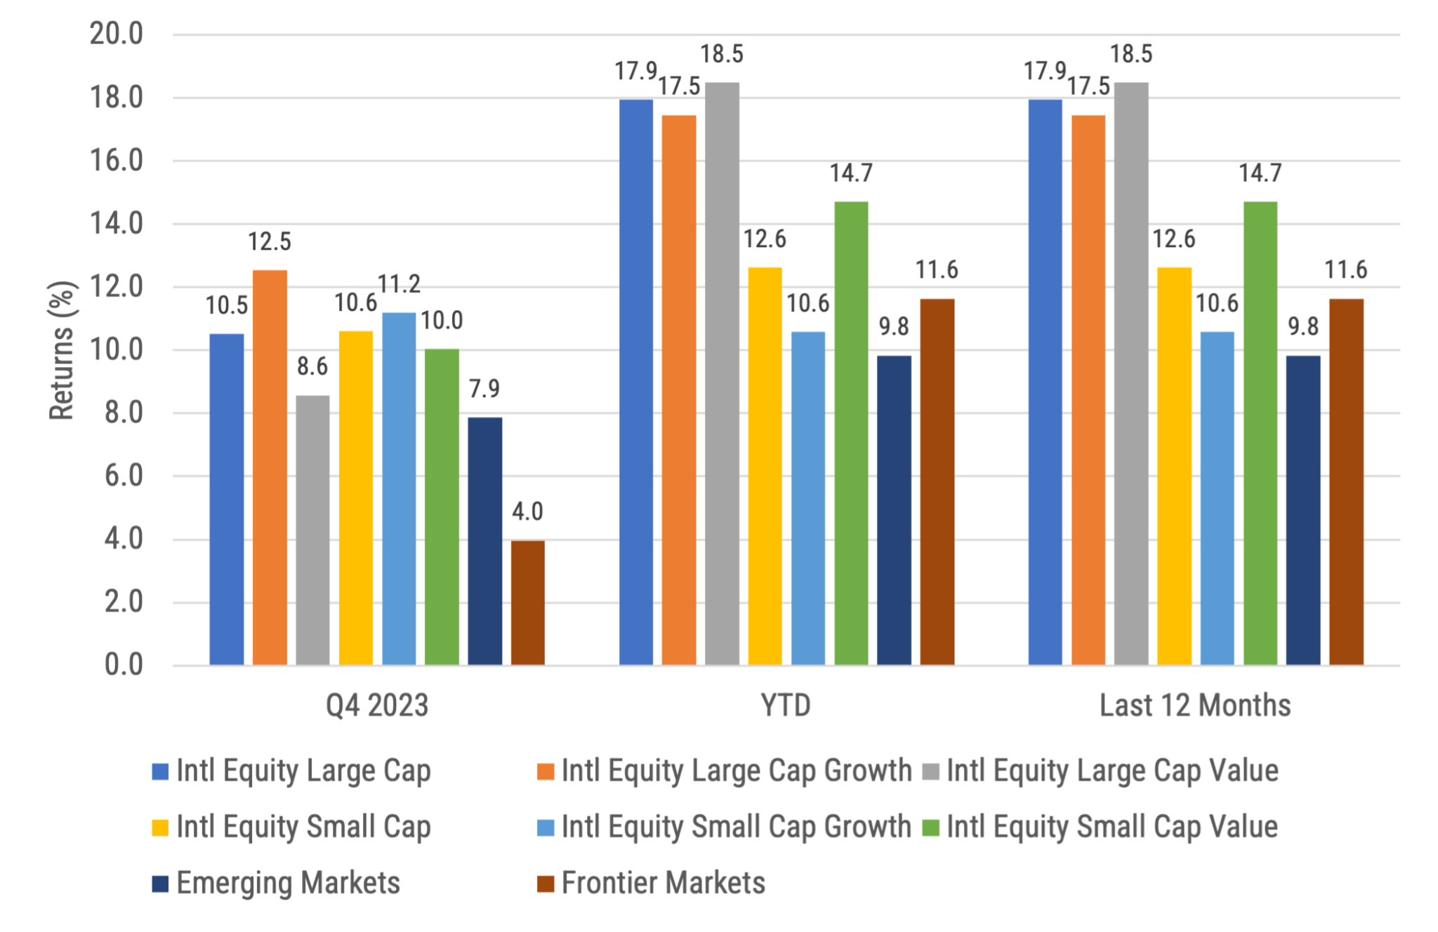
International developed, emerging & frontier stock returns
Source: Morningstar, MSCI benchmark shown. Past performance is not indicative of future results.
Notes:
Similar to the US, non-US stock returns were quite strong in Q4 and for the year. International large caps outperformed their small cap peers for the year, as well as outperforming emerging market and frontier stocks.
Unlike the S&P 500, whose return is dominated by just a few stocks, international indexes are currently more balanced and diversified. The top ten stocks in the MSCI World ex-US IMI returned 18.3% during 2023, while the remaining stocks generated a very similar return of 18.0%.

Slide 16
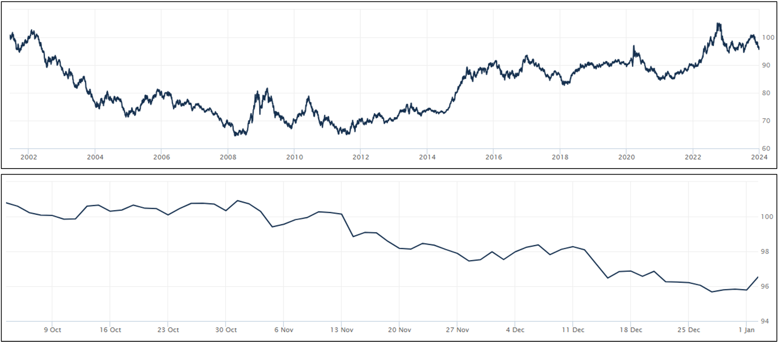
Dollar Strength:
Good for US Consumers, bad for owners of non-US Investments
Source: Wall Street Journal as January 2, 2024. Past performance is not indicative of future results.
Notes:
WSJ’s Dollar Index (BUXX) represents the value of the USD relative to a basket of 16 foreign currencies.
A rising dollar is generally good for US consumers as it makes foreign goods cheaper to purchase, but bad for owners of non-dollar-denominated assets, such as foreign stocks. Said differently, a strong dollar hurts international returns. A strong dollar also hurts US exports and therefore can also negatively impact US production and employment.
The top chart shows the movement over the last 20 years for longer term trends while the bottom chart shows the last 3 months where the dollar fell over the quarter. The top chart shows the dollar is currently still stronger than most other time since the inception of this WSJ Dollar Index. A continued US Dollar decline would be a tailwind for non-US equity returns to be stronger vs. US equities.
For 2023, while the USD had periods of strength and weakness relative to other currencies throughout the year, it ultimately fell slightly for the year. The BUXX index level at the end of 2022 was 96.56 and was 95.83 at the end of 2023, for a loss of less than 1%.

Slide 17
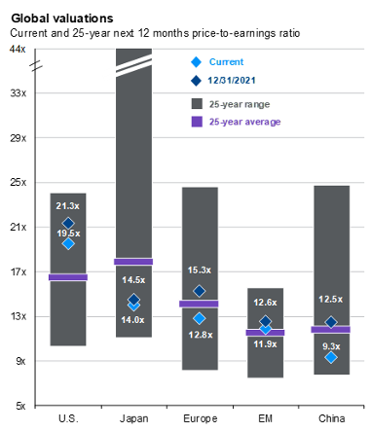
International stocks are undervalued relative to US
Source: FactSet, MSCI, Standard & Poor’s, J.P. Morgan Asset Management. MSCI Europe includes the eurozone as well as countries not in the currency bloc, such as Norway, Sweden, Switzerland and the UK (which collectively make up almost half of the overall index). Past performance is not a reliable indicator of current and future results. (Right) The purple lines for EM and China show 20-year averages due to a lack of available data. Guide to the Markets – U.S. Data are as of December 31, 2023.
Notes:
A common question we receive is “why should we own non-US stocks when US stocks have outperformed non-US stocks for most of the last decade or so?”
One reason why we like intl stocks is for diversification. While US stocks have outperformed more recently, that hasn’t always been the case. In fact, you only need to go back to the 2000’s to find the last period when intl stocks outperformed. Remember the “lost decade” when the S&P 500 earned almost no return?
As we showed on the last slide, the US Dollar is also relatively strong vs. a basket of other currencies. If the USD were to weaken, it would be a tailwind for non-US stocks.
And finally, as this chart shows, not only are most non-US stocks currently undervalued vs. their last 25 year averages, they are also well undervalued relative to US stocks, which are currently overvalued vs. their last 25 yrs

Slide 18
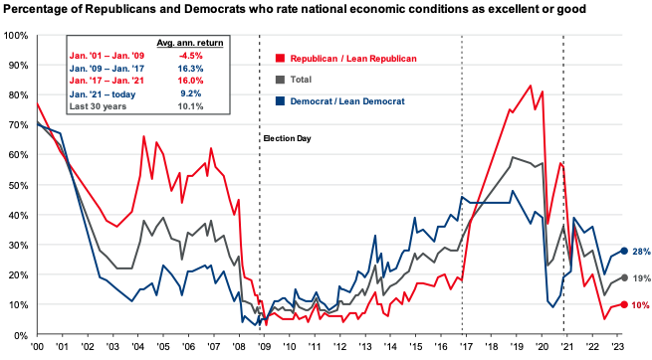
Don’t let politics drive your financial plan
Source: Pew Research Center, J.P. Morgan Asset Management. Pew Research Center, “Republicans, Democrats Move Even Further Apart in Coronavirus Concerns.” Question: Thinking about the nation’s economy, How would you rate economic conditions in this country today… as excellent, good, only fair, or poor? The survey was last conducted in March 2023. Guide to the Markets – U.S. Data are as of December 31, 2023.
Notes:
2024 is a presidential election year. And even though we know clients can have varying political opinions, we wanted to address the topic head on.
The chart shows the average percentage of respondents rating the economy as good by political party for each year. What we know from looking at historical data is that the economy rating gap between the Democrats and Republicans — the difference between the percentage of each saying good — has increased since the early 2000s’s, during the Republican George W. Bush's administration. Since then, how Americans assess the economy began to be viewed more through a political lens, and this became more connected to the party of the sitting president. In more recent years, the pace at which this gap emerges has accelerated, a further sign that views of the economy have often become a proxy for views of the sitting president.
The question is, should your political opinions drive how you invest? In our opinion, no, they shouldn’t. Historically, there has been little to no correlation between the political party in the White House and how markets have performed.
To provide an example, let’s say you were a Republican when President Obama’s term started, were strongly against his policies, and decided to not invest during his presidential terms. If you would have done this, you would have missed out on annualized returns of 16.3%. Missing out on these returns would not have been favorable for your long term financial plans.
Now let’s say you were a Democrat when President Trump went into office, were against his policies, and decided to not invest during his presidential terms. If you would have done this, you would have missed out on annualized returns of 16.0%. Like in the previous scenario, missing out on these returns would not have been favorable for your long term financial plans either.
In other words, don’t let your political opinions drive your investment plans.

Slide 19
Maintain your focus on what really matters
Financial Planning is a process, not an endpoint
Concentrate on long-term goals and objectives
Focus on reaching goals, not on beating benchmarks
Maintain a disciplined approach, in good and bad markets
Invest broadly and globally; asset allocation is key
Reduce investment and tax costs where possible
Rebalance as necessary
Notes:
Do investments matter? Of course they do; however it is not investments alone that will help you achieve your goals. Maintaining a focus on these bullet points is what really matters in helping you achieve your goals.

Slide 20
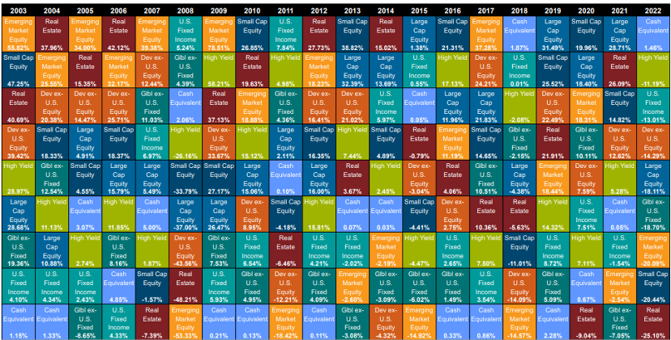
Diversification matters
Source: Callan, Large Cap Equity = S&P 500, Small Cap Equity = Russell 2000, Developed ex-US Equity = MSCI World ex-USA, Emerging Markets Equity = MSCI Emerging Markets, US FI = Bloomberg US Aggregate, High Yield = Bloomberg Corp High Yield, Global ex-US FI = Bloomberg Global Aggregate ex-US, Real Estate = FTSE EPRA Nareit Developed REIT Index, Cash Equivalent = 90 day T-bill
Notes:
In Q3 2020, this chart was changed to the Callan chart, which is only updated annually. It was changed to this chart to show a greater number of annual periods.
The chart is updated during the first quarter each year so it will still be the previous years chart in the Q4 version each year.
Note that in 2021, the chart started the inclusion of hedge funds.

Slide 21
Questions?

Slide 22
Disclosures
This information is not intended to be used as the primary basis for investment decisions, nor should it be construed as advice designed to meet the particular needs of an individual investor. Investing in mutual funds, ETFs, and other equity and debt securities involves risk, including loss of principal. An investor should consider a portfolio’s investment objectives, risks, and expenses carefully before investing. Please read any applicable funds’ prospectus carefully before investing. Investors cannot invest directly in an index. Indexes are unmanaged and reflect reinvested dividends and/or distributions, but do not reflect sales charges, commissions, expenses or taxes.
XYPN Invest constructs and manages investment models (“Model Portfolios”) through a technology solution. The Model Portfolios can be used by independent registered investment advisers (“RIAs”) that are members of XYPN, but not affiliated with the XYPN Invest. XYPN Invest manages its Model Portfolios on a discretionary basis primarily by allocating assets among various mutual funds and exchange-traded funds (“ETFs”). XYPN Invest may also allocate assets in individual debt and equity securities. While XYPN Invest will select mutual funds and ETFs for the Model Portfolios, provide guidance and information about the Model Portfolios to RIAs, RIAs are responsible for choosing the specific model and allocation for each of their Clients.

