Slide 1
2023 Q3
Quarterly Market Review
Presented By: Mario Nardone

Slide 2
Positive Signals
Reasons for Concern
Government shutdown was averted at September month-end, though limited market impact was expected.
There is more “Income” from fixed income than there has been in years.
Labor market remains strong.
Expectations are the Fed will keep rates higher for longer, contributing to higher intermediate and longer-term yields.
US large cap stocks’ return is being driven by only a small number of mega-cap stocks
The stronger US Dollar negatively impacted the returns of non-US stocks, and the returns of multinational US companies.
Notes:
As always, we like to take a balanced approach to looking at the global economy and markets, not reacting too positively or negatively to any news.

Slide 3
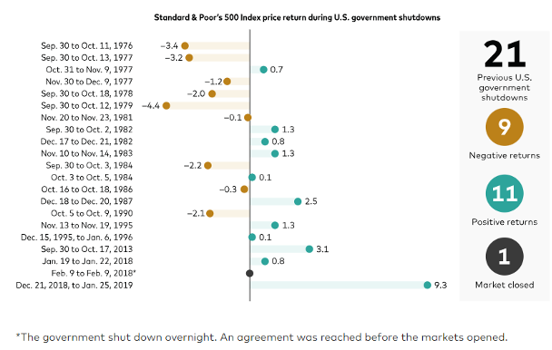
Market Impacts from Government Shutdowns
Source: Vanguard calculations, based on data from FactSet and the Congressional Research Service. Past performance is not indicative of future results.
Notes:
Congress came to a compromise at the end of September to avoid a government shutdown, at least for now, as the bill just signed only funds the government through November 17, 2023. Should investors be concerned about a shutdown having a significant negative impact on the economy and markets? No, if history is any indication. Overall, there have been 21 government shutdowns since 1976. and one could classify the mixed market results as noise. In summary, of the 21 previous shutdowns, 11 saw the S&P move in a positive direction during the shutdown with nine experiencing declines (one shutdown occurred overnight, when markets were closed, so there was no market impact).

Slide 4
It’s all about the Fed’s pace, pause, & pivot
Notes:
For the last several quarters, we have spoken about the three P’s of pace, pause, and pivot. We had noted the Fed’s pace of rate increases has slowed as the last several increases have only been 25 bps. We also noted that there is a lag in the amount of time when these increases occur to when it’s actually seen in the data.

Slide 5
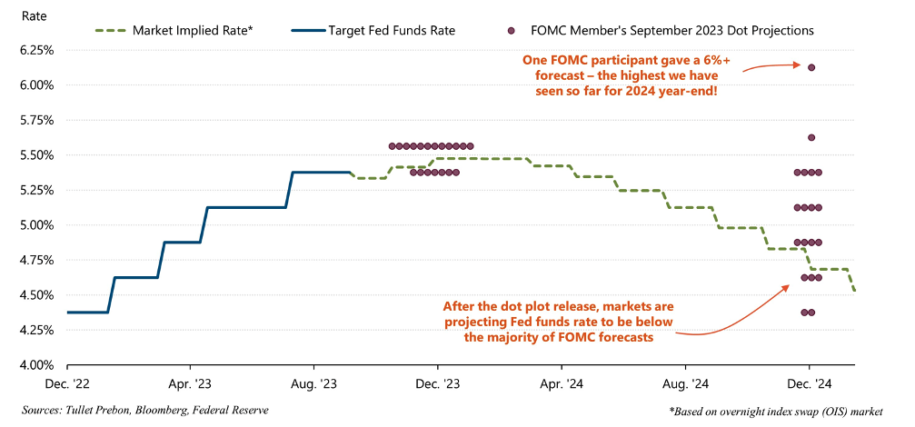
Fed projections & market implied rates
Sources: Tullet Prebon, Bloomberg, Federal Reserve
Notes:
There are a few interesting take-aways from this chart.
First, look at the December 2024 column and note the differences in projections from various Fed members, with some believing the Fed Fund rate will be between 4.25-4.5%, while one participant has a 6% forecast.
A second take-away is looking at the nice, calm stepdown in the market implied rate from December 2023 through 2024. In a sense, the implied stepdown is the mirror image of what happened on the way up from December 2022 through the current time period. However, as the following slide shows, the even-paced stepdown in rates is unlikely if history is our guide.

Slide 6
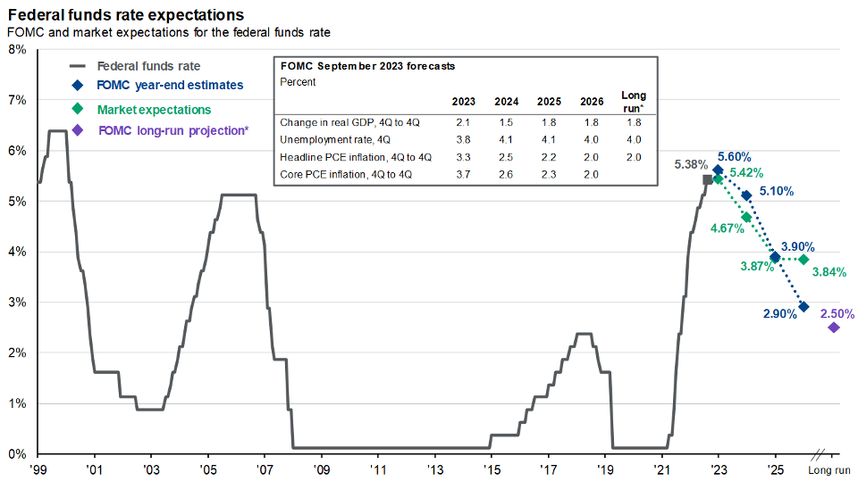
Rates up via escalator, down via elevator
Source: Bloomberg, FactSet, Federal Reserve, J.P. Morgan Asset Management. Market expectations are based off of USD Overnight Index Swaps. *Long-run projections are the rates of growth, unemployment and inflation to which a policymaker expects the economy to converge over the next five to six years in absence of further shocks and under appropriate monetary policy. Forecasts are not a reliable indicator of future performance. Forecasts, projections and other forward-looking statements are based upon current beliefs and expectations. They are for illustrative purposes only and serve as an indication of what may occur. Given the inherent uncertainties and risks associated with forecasts, projections or other forward-looking statements, actual events, results or performance may differ materially from those reflected or contemplated. Guide to the Markets – U.S. Data are as of September 30, 2023.
Notes:
What this chart shows is that while rates may go up like an escalator, they tend to come down in an elevator. In other words, they tend to come down faster than they go up. This is often because there is some type of event (e.g. financial crisis, Covid) that causes the Fed to act quickly and decisively.

Slide 7
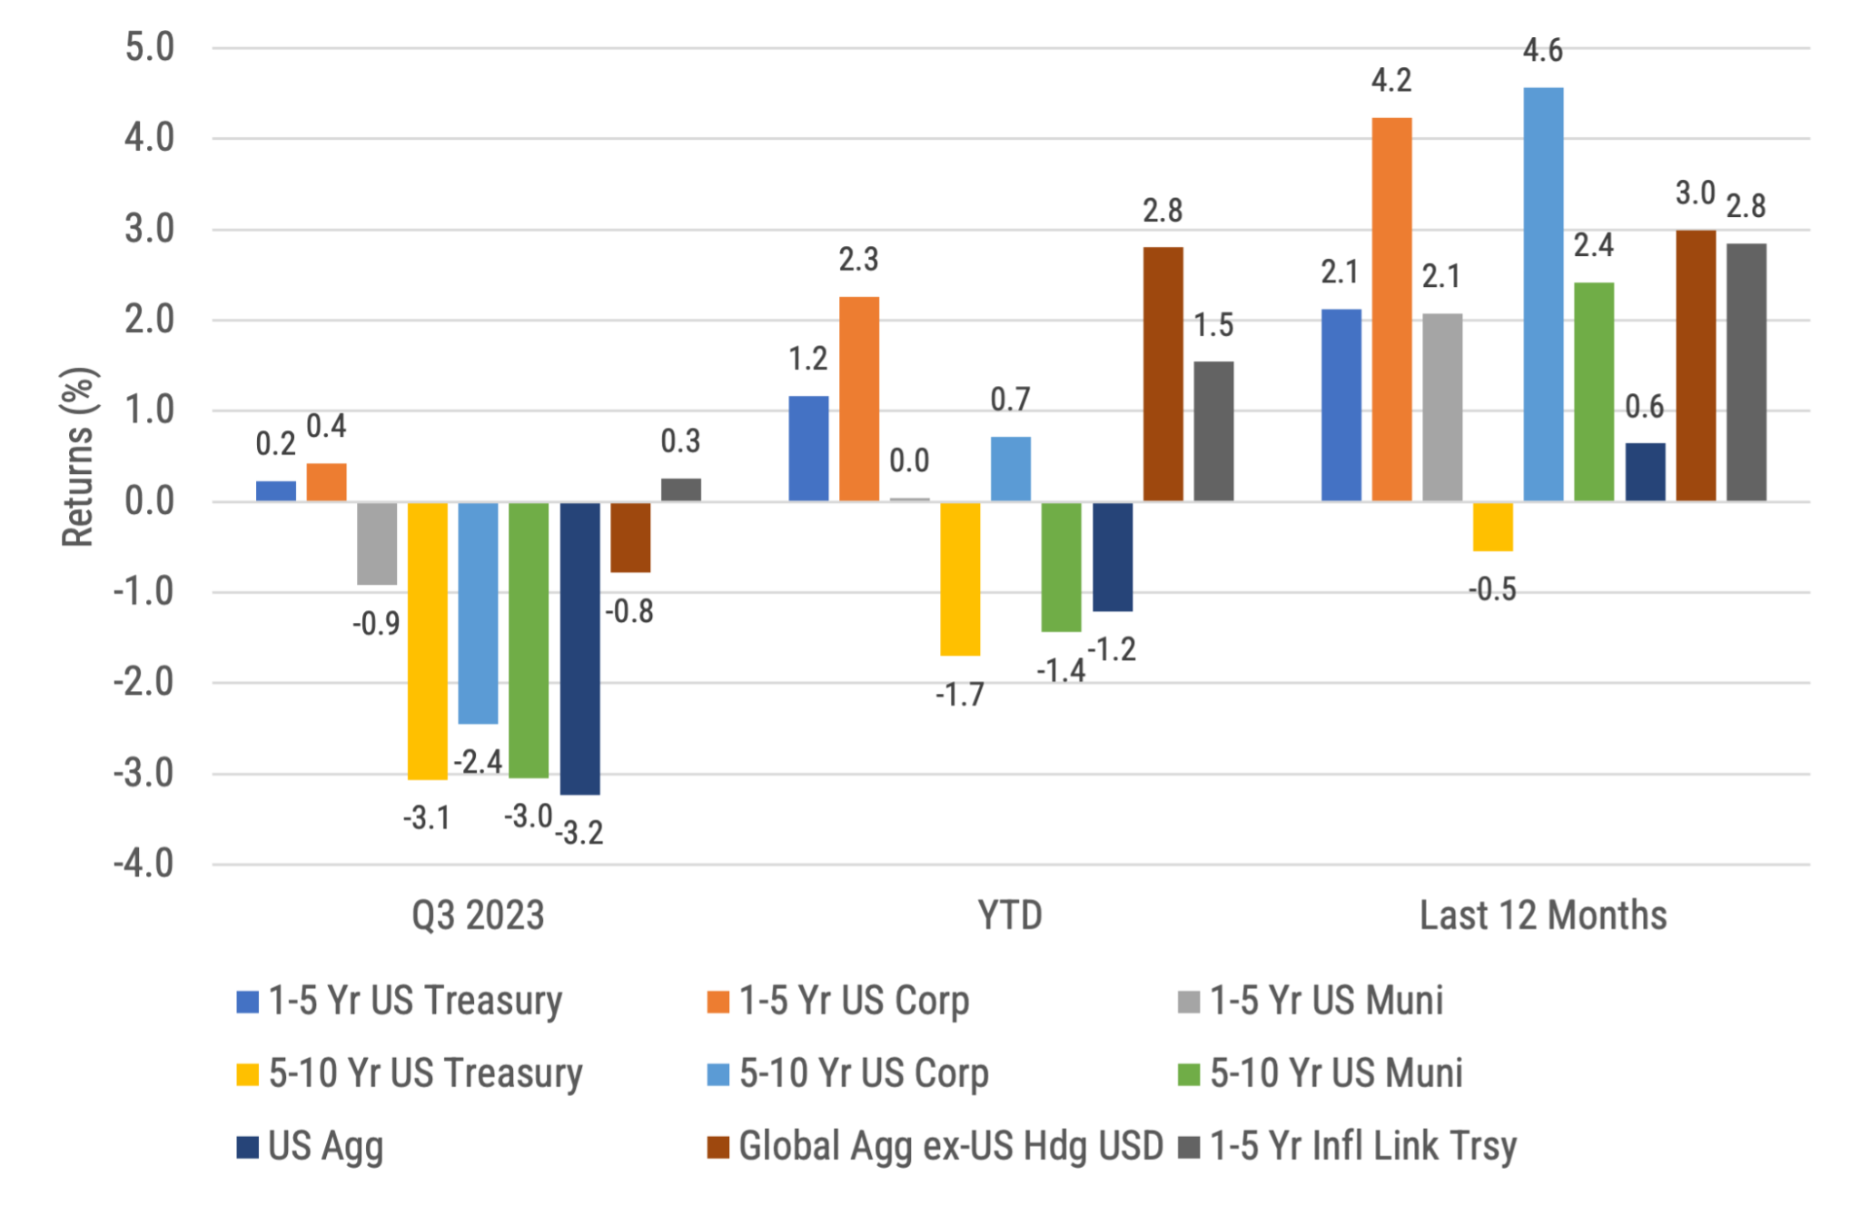
Global Bond Returns
Source: Morningstar, Bloomberg and ICE BofA ML benchmarks shown. Past performance is not indicative of future results.
Notes:
Fixed income investors expect to be compensated for holding longer maturity bonds vs. shorter maturity bonds, which is known as the term premium. As short-term yields rose, we saw an even greater increase in yields over the quarter across the intermediate and longer-term parts of the yield curve, influenced by many different factors. As prices move inverted to yields, most bond indexes experienced negative returns over the quarter.

Slide 8
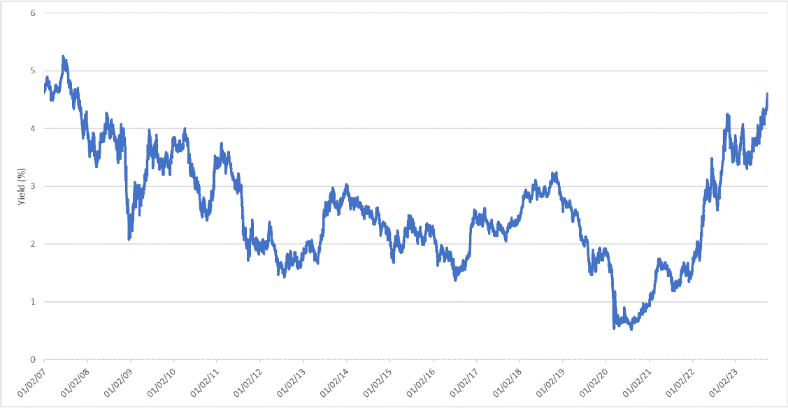
10 Year Treasury continues to move higher
Source: US Department of the Treasury, data through September 29. Y-axis shows % yield. X-axis shows time.
Notes:
The 10-Yr Treasury is a barometer of sorts as it can be used as a benchmark to measure investor confidence, but it’s also important because it influences rates set for mortgages and other types of debt.

Slide 9
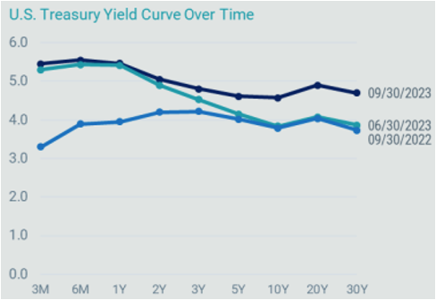
A less inverted Treasure curve, but rates still moving higher
Source: Bloomberg, data as of 9/30/23
Notes:
As you can see, yields moved higher across the Treasury curve over the quarter, and more specifically over the intermediate and longer parts of the curve, with the curve being less inverted than it was a few months ago.

Slide 10
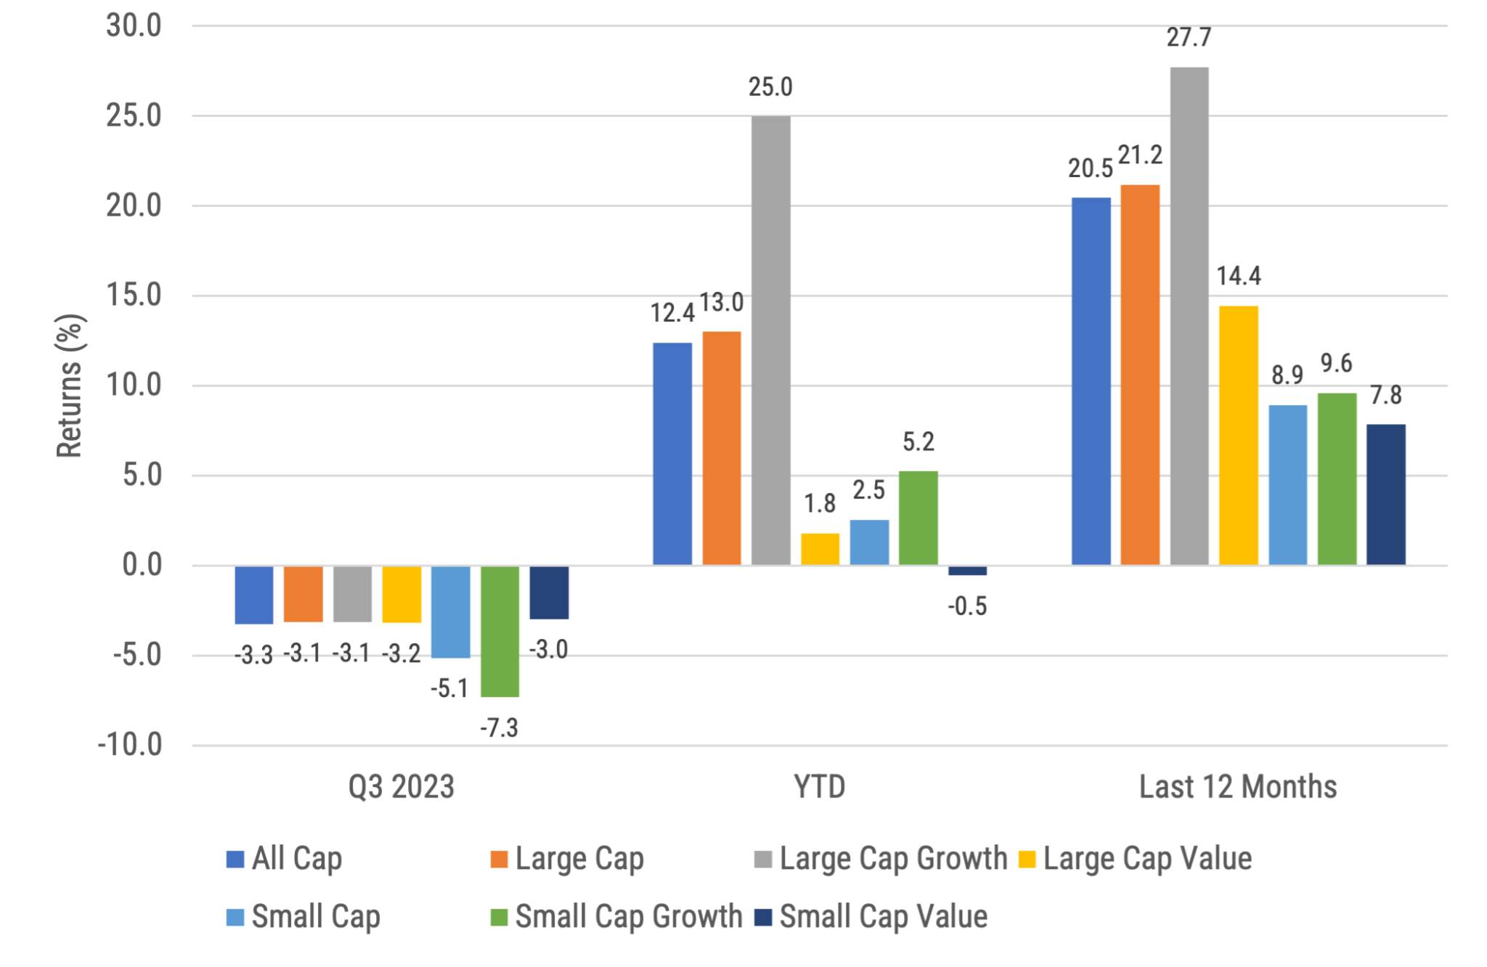
US Stock Returns by size and style
Source: Morningstar, Russell benchmarks shown. Past performance is not indicative of future results.
Notes:
All US stock indexes fell the quarter, with large cap stocks outperforming smaller ones.
Large growth stocks have for the highest year-to-date (YTD) returns (+25.0%), but returns are only being driven by a few stocks.

Slide 11
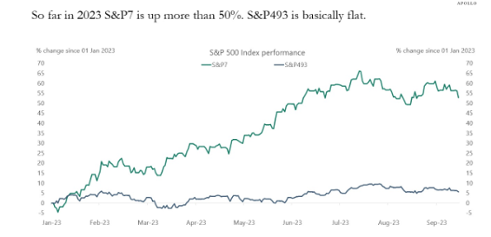
S&P 493 is basically flat for this year
Source: Bloomberg, Apollo Chief Economist, https://apolloacademy.com/sp493-is-basically-flat-this-year/ posted 9/22/2023 This presentation may not be distributed, transmitted or otherwise communicated to others in whole or in part without the express consent of Apollo Global Management, Inc. (together with its subsidiaries, “Apollo”) Apollo makes no representation or warranty, expressed or implied, with respect to the accuracy, reasonableness, or completeness of any of the statements made during this presentation, including, but not limited to, statements obtained from third parties. Opinions, estimates and projections constitute the current judgment of the speaker as of the date indicated. They do not necessarily reflect the views and opinions of Apollo and are subject to change at any time without notice.Apollo makes no representation or warranty, expressed or implied, with respect to the accuracy, reasonableness, or completeness of any of the statements made during this presentation, including, but not limited to, statements obtained from third parties. Opinions, estimates and projections constitute the current judgment of the speaker as of the date indicated. They do not necessarily reflect the views and opinions of Apollo and are subject to change at any time without notice.
Notes:
The seven biggest stocks in the S&P 500 are up more than 50% in 2023.
The remaining 493 stocks are basically flat.
The bottom line is that if you buy the S&P 500 today, you are basically buying a handful of companies that make up 34% of the index and have an average P/E ratio around 50.

Slide 12
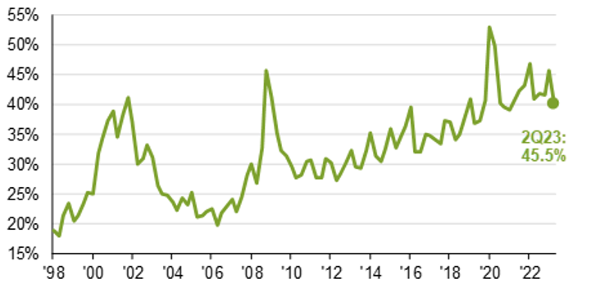
Making a profit?
Slide shows percent of unprofitable companies in the Russell 2000. 1Q98-2Q23, pro-forma EPS. Source: Compustat, FactSet, FTSE Russell, NBER, J.P. Morgan Asset Management. The S&P 500 is used for large cap and the Russell 2000 is used for small cap. Guide to the Markets – U.S. Data are as of September 30, 2023.
Notes:
A challenge for the Russell 2000, and one of the reasons why we it isn’t one of our favorite indexes to track for investment purposes, is that as of quarter end, 45.5% of the companies held in the Russell 2000 (roughly 900 companies) are not profitable (see Exhibit 2). It just makes economic sense that, over time, companies that are profitable should outperform companies that are not profitable. Ultimately, if a company keeps losing money, it may not be in business for very long.
A preferred approach, in particular in small cap stocks, is to focus on companies that are more profitable vs. those that are not. As a comparison, the S&P 600 is another index that invests in small cap stocks, yet unlike the R2000, it does include a positive earnings requirement, which is a fair, even if imperfect, proxy for profitability in its index construction rules. If you look at the last 20 years ending 9/30/2023, the S&P 600 has earned 1.5% more per year on average vs. the R2000. While we cannot attribute the entire difference to just the S&P’s inclusion of profitability, we do believe it is an important component.

Slide 13
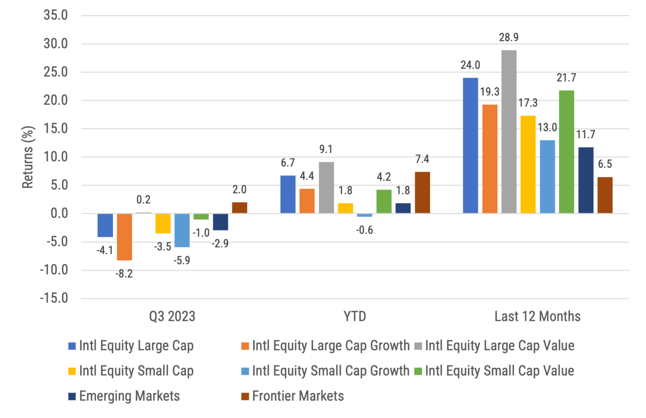
International developed, emerging & frontier stock returns
Source: Morningstar, MSCI benchmark shown. Past performance is not indicative of future results.
Notes:
Q3 2023 includes the change from MSCI EAFE to MSCI World ex-US in the large cap and small cap spaces (in order to include Canada). Plus, newly added are the growth and value components for large and small cap.

Slide 14
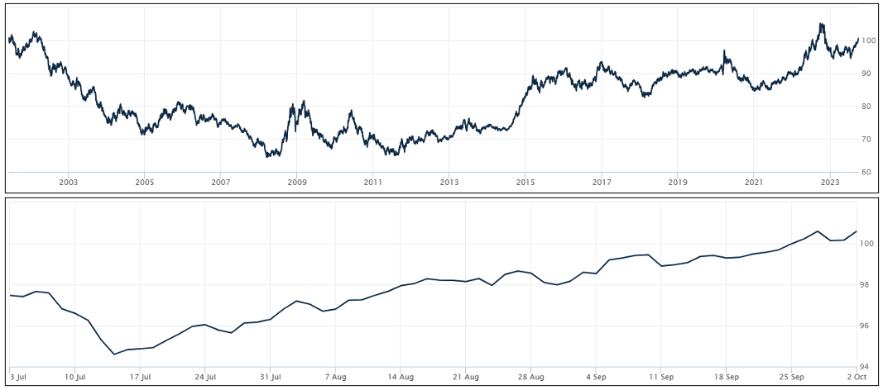
Dollar Strength:
Good for US Consumers, bad for owners of non-US Investments
Source: Wall Street Journal as October 2, 2023. Past performance is not indicative of future results.
Notes:
WSJ’s Dollar Index (BUXX) represents the value of the USD relative to a basket of 16 foreign currencies.
A rising dollar is generally good for US consumers as it makes foreign goods cheaper to purchase, but bad for owners of non-dollar-denominated assets, such as foreign stocks. Said differently, a strong dollar hurts international returns. A strong dollar also hurts US exports and therefore can also negatively impact US production and employment.
The rising US Dollar relative to foreign currencies was another factor in the quarterly underperformance of non-US stocks relative to US stocks. To put this in numeric terms, let’s look at a common non-US benchmark, the MSCI World ex USA. The return of the index in dollar terms (which is what a US investor would receive assuming the return is unhedged) over the previous quarter was -4.1%, but it was -1.35% in local currency terms. In other words, the stronger dollar cost US investors 2.75% in return over the last three months.
The top chart shows the movement over the last 20 years for longer term trends while the bottom chart shows the last 3 months where the dollar fell over the quarter. The top chart shows the dollar is currently still stronger than most other time since the inception of this WSJ Dollar Index. Having the US Dollar continue to decline further would be a catalyst for non-US equity returns to be stronger vs. US equities.
The bottom chart shows an increase in the dollar overall for the quarter.

Slide 15
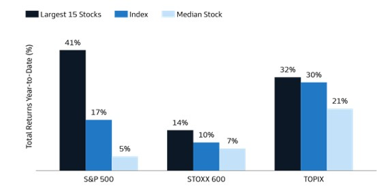
International markets are more balanced
Source: Bloomberg and GS Asset Management, as of September 17, 2023. Past performance is not indicative of future results.
Notes:
Unlike the S&P 500, whose return is dominated by just a few stocks, international indexes are currently more balanced and diversified. Per Exhibit 3, if you held the largest 15 stocks in the STOXX 600 (representative of European stocks), the YTD return through 9/17/2023 was 14% vs. 10% for the entire index. Similarly, the TOPIX (Tokyo Stock Exchange) also shows considerably less concentration regarding its overall return being driven by the top 15 holdings. Overall, a market that has more breadth of winners is often believed to be a healthier market.

Slide 16
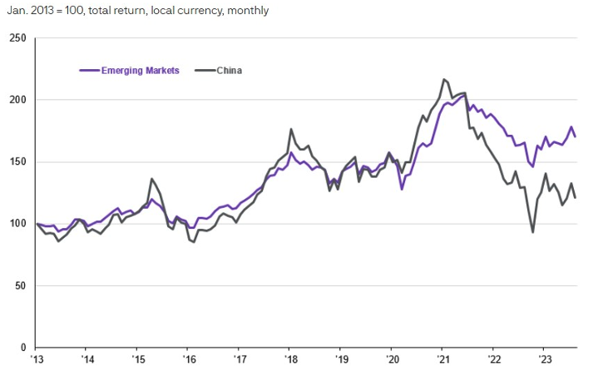
Emerging Market vs. China
Source: FactSet, MSCI, JPMorgan Asset Management. Emerging Markets = MSCI Emerging Markets Total Return Index, China = MSCI China Total Return Index. Data are as of September 12, 2023. Past performance is not indicative of future results.
Notes:
Recently, there have been plenty of negative headlines related to China, both political and economic, resulting in inquiries about possibly divesting from Chinese stocks. As we have previously noted, China constitutes roughly 1/3 of emerging markets stocks and is the second largest economy in the world, making it sort of a big “call” to exclude such a large player. Plus, if you remove China from an emerging markets allocation, the unintended impact is that you now overweight all the remaining countries, which may not necessarily provide a better outcome. Overall, it is not our general approach to make “bets” for or against specific countries and would recommend staying invested as long as Chinese markets remain open and don’t have issues with market pricing.
Interestingly, while the return of emerging markets in general has tracked closely with returns of China, that has started to change. In fact, after China, the next largest countries considered emerging markets can include India, Taiwan, Korea, and Brazil, and all four have outperformed China over the last 12 months.

Slide 17
Maintain your focus on what really matters
Financial Planning is a process, not an endpoint
Concentrate on long-term goals and objectives
Focus on reaching goals, not on beating benchmarks
Maintain a disciplined approach, in good and bad markets
Invest broadly and globally; asset allocation is key
Reduce investment and tax costs where possible
Rebalance as necessary
Notes:
Do investments matter? Of course they do; however it is not investments alone that will help you achieve your goals. Maintaining a focus on these bullet points is what really matters in helping you achieve your goals.

Slide 18
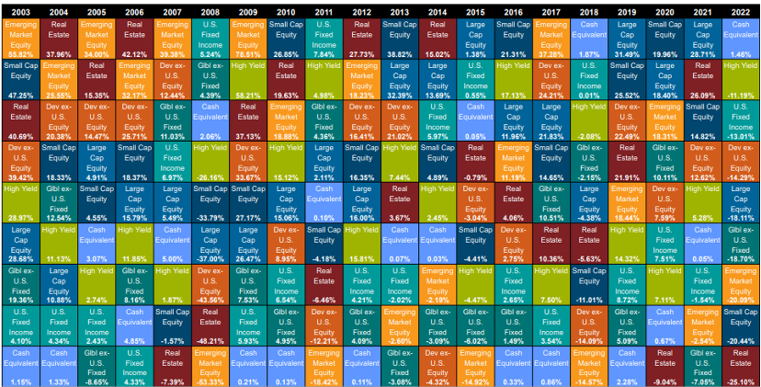
Diversification matters
Source: Callan, Large Cap Equity = S&P 500, Small Cap Equity = Russell 2000, Developed ex-US Equity = MSCI World ex-USA, Emerging Markets Equity = MSCI Emerging Markets, US FI = Bloomberg US Aggregate, High Yield = Bloomberg Corp High Yield, Global ex-US FI = Bloomberg Global Aggregate ex-US, Real Estate = FTSE EPRA Nareit Developed REIT Index, Cash Equivalent = 90 day T-bill
Notes:
In Q3 2020, this chart was changed to the Callan chart, which is only updated annually. It was changed to this chart to show a greater number of annual periods.
The chart is updated during the first quarter each year so it will still be the previous years chart in the Q4 version each year.
Note that in 2021, the chart started the inclusion of hedge funds.

Slide 19
Questions?

Slide 20
Disclosures
This information is not intended to be used as the primary basis for investment decisions, nor should it be construed as advice designed to meet the particular needs of an individual investor. Investing in mutual funds, ETFs, and other equity and debt securities involves risk, including loss of principal. An investor should consider a portfolio’s investment objectives, risks, and expenses carefully before investing. Please read any applicable funds’ prospectus carefully before investing. Investors cannot invest directly in an index. Indexes are unmanaged and reflect reinvested dividends and/or distributions, but do not reflect sales charges, commissions, expenses or taxes.
XYPN Invest constructs and manages investment models (“Model Portfolios”) through a technology solution. The Model Portfolios can be used by independent registered investment advisers (“RIAs”) that are members of XYPN, but not affiliated with the XYPN Invest. XYPN Invest manages its Model Portfolios on a discretionary basis primarily by allocating assets among various mutual funds and exchange-traded funds (“ETFs”). XYPN Invest may also allocate assets in individual debt and equity securities. While XYPN Invest will select mutual funds and ETFs for the Model Portfolios, provide guidance and information about the Model Portfolios to RIAs, RIAs are responsible for choosing the specific model and allocation for each of their Clients.

