Slide 1
Monthly Office Hours
February 14, 2024

Slide 2
Market Update
As of January 31, 2024
Positive Signals
Reasons for Concern
The S&P closed at a record high on January 29, 2024
Large-cap performance was positive in the US and abroad
Treasuries and Corporate bonds were positive in short-term and intermediate-terms ranges.
Small-cap and emerging market asset classes were down
Municipal bonds were down.

Slide 3
Welcome to the team!
North Carolina
Nebraska
Colorado

Slide 4
We’ve moved our secure file sharing to Box.com
Our service forms and email signatures have updated links to upload files securely to Box.com
Please discontinue use of any ShareFile links you have saved

Slide 5
Question: How do I find a client’s total IRA contributions for 2023?

Slide 6
Practice Management Tip:
Save signed Schwab forms in your files!

Slide 7
Advisor Portal Tip:
You can only click “E-Sign via email” once. Clicking it again will create a duplicate Docusign Envelope.

Slide 8
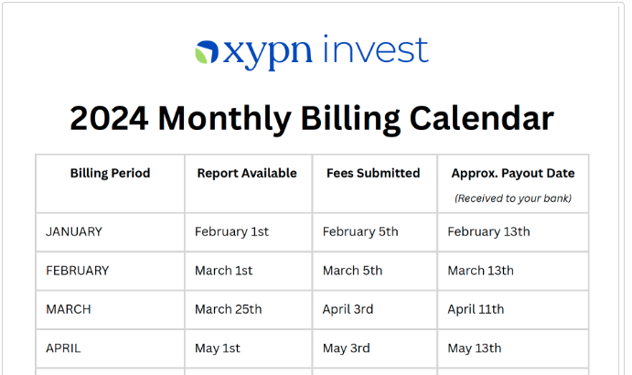
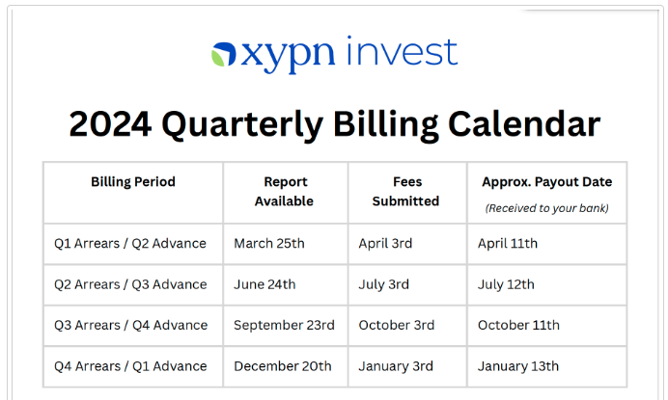
2024 Billing Calendar
Upcoming billing dates are posted in the XYPN Invest Knowledge base

Slide 9
Important Dates
1
Office Closed: President’s Day
Monday, February 19, 2024
2
IRA Contribution Deadline Friday, March 29, 2024

Slide 10
Congrats to Nate Baim!
Highest % change in AUM for January 2024

Slide 11
Questions?

Slide 12
Disclosures
This information is not intended to be used as the primary basis for investment decisions, nor should it be construed as advice designed to meet the particular needs of an individual investor. Investing in mutual funds, ETFs, and other equity and debt securities involves risk, including loss of principal. An investor should consider a portfolio’s investment objectives, risks, and expenses carefully before investing. Please read any applicable funds’ prospectus carefully before investing. Investors cannot invest directly in an index. Indexes are unmanaged and reflect reinvested dividends and/or distributions, but do not reflect sales charges, commissions, expenses or taxes.
XYPN Invest constructs and manages investment models (“Model Portfolios”) through a technology solution. The Model Portfolios can be used by independent registered investment advisers (“RIAs”) that are members of XYPN, but not affiliated with the XYPN Invest. XYPN Invest manages its Model Portfolios on a discretionary basis primarily by allocating assets among various mutual funds and exchange-traded funds (“ETFs”). XYPN Invest may also allocate assets in individual debt and equity securities. While XYPN Invest will select mutual funds and ETFs for the Model Portfolios, provide guidance and information about the Model Portfolios to RIAs, RIAs are responsible for choosing the specific model and allocation for each of their Clients.

