Slide 1
Monthly Office Hours

Slide 2
Agenda
November 8, 2023
1
New Team Members
Investment Policy Committee
3
Welcome to Violet Zinkerman and Ana George
A report of open projects with the IPC
2
Market Update
Briefly exploring the latest positive signals and reasons for concern

Slide 3
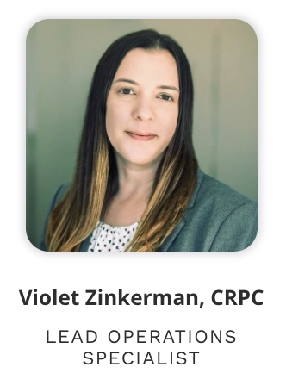
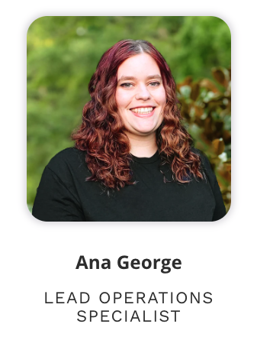
New team members!

Slide 4
Market Update
As of October 31, 2023
Positive Signals
Reasons for Concern
MSCI ACWI is still posting a +6.7% return YTD and a +10.5% return over the last 12 months
Global diversification paid off: The S&P 500 was 10.1% over the last 12 months, compared to the MSCI World ex-USA at 12.6% and the MSCI EM at 10.8%
Bond yields are rising
No single cause to blame: Maybe the Fed, maybe belief of an impending recession, maybe the war in the Middle East, or maybe stocks were just too expensive
Poor performance across the board for 1-month and 3-month periods
Small and value are the worst performers

Slide 5
Investment Policy
Committee Report
1
Trading & Error Policies
Core & Core W DFA Merger
3
2
Bond Trading
4
Dividend Reinvestment

Slide 6
Core/Core W DFA Model Merger
Beginning Dec 1, 2023
Current holdings will be used as equivalents to reduce tax impact.
401Ks, IRAs, ROTHs will experience full conversions to the new model.
Final selection of funds will on the next slide.
Equity managers include Vanguard, DFA, and Avantis.

Slide 7
The New Core Model
Beginning Dec 1, 2023
 |  | Standard Model |  |  |  | Tax-Sensitive Model
Asset Class | Fund | Ticker | Alt. | Target |  | Ticker | Alt. | Target
Large Blend | Vanguard Total Stock Market | VTI | IWV | 30.0% |  | VTI | IWV | 30.0%
Small Value | DFA US Small Cap Value | DFSV | AVUV | 20.0% |  | DFSV | AVUV | 20.0%
Foreign Large Blend | Vanguard FTSE Developed Mkts | VEA | IEFA | 20.0% |  | VEA | IEFA | 20.0%
Foreign Sm/Mid Value | Avantis International Small Cap Value | AVDV | DISV | 10.0% |  | AVDV | DISV | 10.0%
Emerging Markets | Avantis Emerging Markets Equity | AVEM | VWO | 15.0% |  | AVEM | VWO | 15.0%
Real Estate | DFA Global Real Estate | DFGR | REET | 5.0% |  | DFGR | REET | 5.0%
Corporate Bond | Vanguard Intermediate Corp | VCIT | SPAB | 20.0% |  | MUNI | MUB | 70.0%
Intermediate Government | SPDR Intermediate Treasury | SPTI | VGIT | 20.0%
World Bond - USD Hedged | Vanguard Total International Bond | BNDX | IAGG | 30.0%
Short Term Bond | Vanguard ST Corporate Bond | VCSH | IGSB | 20.0% |  | SUB | SHM | 20.0%
Inflation Protection | Vanguard ST Inflation Protection | VTIP | STIP | 10.0% |  | VTIP | STIP | 10.0%

Slide 8
Dividend Reinvestment Announcement
Our daily cash management keeps cash balances in check.
Dividend reinvestment arbitrarily reinvests dollars without concern for which position is underweighted
Reinvested dividends complicate tax loss harvesting
We will no longer allow dividend reinvestment, beginning Jan 1, 2024.

Slide 9
Congrats to Cynthia Meyer!
Highest Net New Assets in October 2023.

Slide 10
Important Dates
1
Year-End Processing Deadline
Tuesday, November 28th
Please submit time-sensitive requests for Schwab by the deadline to ensure ample time for processing. This includes RMDs & QCDs, new accounts, roth conversions, etc.

Slide 11
Important Dates (Cont’d)
2
Early Office Closures: 2pm MST
November 20 - 22, 2023
We have scheduled early closures leading up to Thanksgiving to help give our team a break.
3
Thanksgiving Break
Office Closed November 23 - 24, 2023
Our office will be closed on Thanksgiving and Native American Heritage Day

Slide 12
Disclosures
This information is not intended to be used as the primary basis for investment decisions, nor should it be construed as advice designed to meet the particular needs of an individual investor. Investing in mutual funds, ETFs, and other equity and debt securities involves risk, including loss of principal. An investor should consider a portfolio’s investment objectives, risks, and expenses carefully before investing. Please read any applicable funds’ prospectus carefully before investing. Investors cannot invest directly in an index. Indexes are unmanaged and reflect reinvested dividends and/or distributions, but do not reflect sales charges, commissions, expenses or taxes.
XYPN Invest constructs and manages investment models (“Model Portfolios”) through a technology solution. The Model Portfolios can be used by independent registered investment advisers (“RIAs”) that are members of XYPN, but not affiliated with the XYPN Invest. XYPN Invest manages its Model Portfolios on a discretionary basis primarily by allocating assets among various mutual funds and exchange-traded funds (“ETFs”). XYPN Invest may also allocate assets in individual debt and equity securities. While XYPN Invest will select mutual funds and ETFs for the Model Portfolios, provide guidance and information about the Model Portfolios to RIAs, RIAs are responsible for choosing the specific model and allocation for each of their Clients.

