Slide 1
Monthly Office Hours
August 9, 2023

Slide 2
Agenda
Model Updates
TD/Schwab Transition
Investment Proposal Updates
Upcoming CE Webinars
Investment Committee Report
Advisor Growth Award
Important Dates
Q&A

Slide 3
Model Updates

Slide 4
BRI Model Changes
The Timothy and Eventide mutual funds have been closed to new Schwab advisors for some time. In July, these funds were closed to existing Schwab advisors as well.
We rebuilt the model using Timothy Plan ETFs in the equity allocation and utilizing the Core model’s fixed income sleeve.
This change is effective as of 8/1
Check out the changes in our model kit!

Slide 5
TD/Schwab Transition

Slide 6
TD/Schwab Transition
Please submit all TD requests to XYIS by Friday, August 11th.
Continue transacting at TD/within VEO One until September 5th
Accounts can be opened at Schwab starting on September 5th
Visit welcomeadvisors.schwab.com for updates and upcoming events

Slide 7
New Investment Proposal (Sneak peak!)

Slide 8
Who wants some CE credit?

Slide 9
CE Webinar Series by XYIS
This month
Coming Soon!
✔ Mortgage Analysis for Financial Planners - August 23rd
✔ Where can Indexes-and Factors-Fall Short? - November 2nd

Slide 10
Investment Committee Report
The latest updates on our priorities on the investment committee.

Slide 11
Investment Committee Report
Current Projects
Projects on the Horizon
✔ BRI Fund Closures
✔ Investments 101 Educational Series
✔ Alternatives
✔ Updates to our Investment Philosophy white paper
✔ Bond Trading

Slide 12
Growth Awards
Recognizing the movers and shakers in our community!

Slide 13
AUM % Increase
Natalie Miller
Grit & Lavender Financial Planning
Brighton, MI
Congratulations!
July 2023

Slide 14
Important Dates
CE Webinar (Mortgage Analysis)
Wednesday, August 23rd at 10 am MST
XYIS Office Hours Wednesday, September 13th at 9 am MST
XYPN LIVE
Stop by our booth - Wednesday, September 20th
Content Session - Thursday, September 21st

Slide 15
Questions?

Slide 16
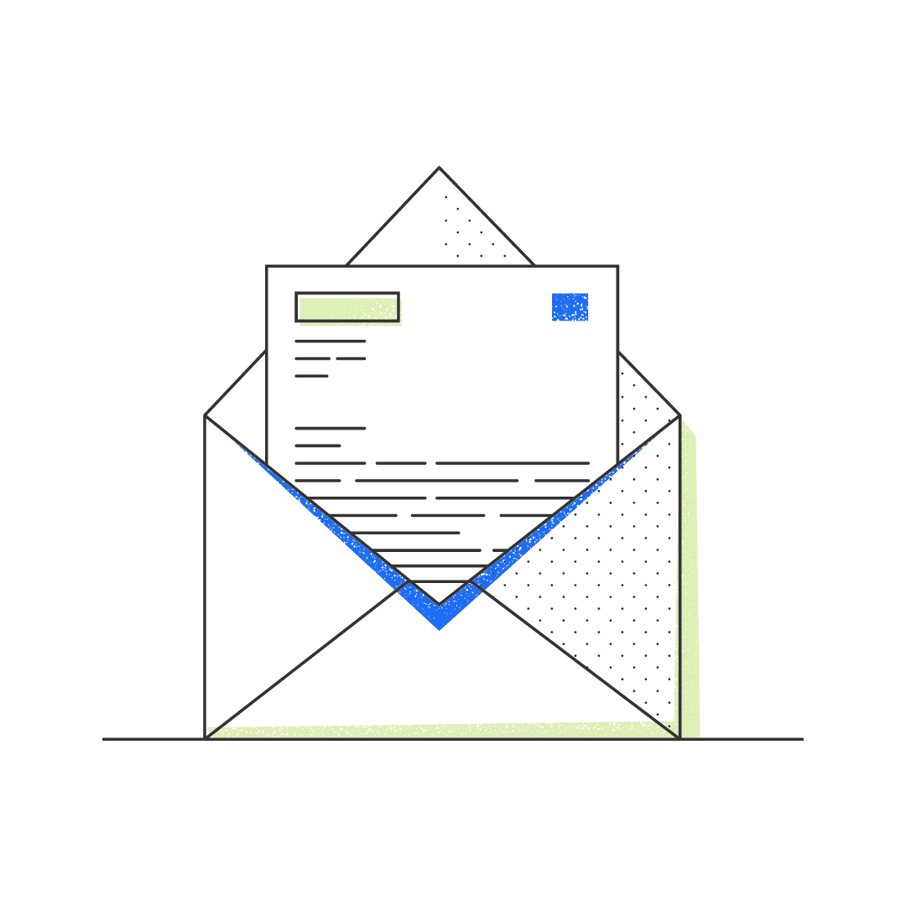
Disclosures
This information is not intended to be used as the primary basis for investment decisions, nor should it be construed as advice designed to meet the particular needs of an individual investor. Investing in mutual funds, ETFs, and other equity and debt securities involves risk, including loss of principal. An investor should consider a portfolio’s investment objectives, risks, and expenses carefully before investing. Please read any applicable funds’ prospectus carefully before investing. Investors cannot invest directly in an index. Indexes are unmanaged and reflect reinvested dividends and/or distributions, but do not reflect sales charges, commissions, expenses or taxes.
XYIS constructs and manages investment models (“Model Portfolios”) through a technology solution. The Model Portfolios can be used by independent registered investment advisers (“RIAs”) that are members of XYPN, but not affiliated with the XYIS. XYIS manages its Model Portfolios on a discretionary basis primarily by allocating assets among various mutual funds and exchange-traded funds (“ETFs”). XYIS may also allocate assets in individual debt and equity securities. While XYIS will select mutual funds and ETFs for the Model Portfolios, provide guidance and information about the Model Portfolios to RIAs, RIAs are responsible for choosing the specific model and allocation for each of their Clients.

