Slide 1
2024 Q1
Quarterly Market Review
Presented By: Mario Nardone

Slide 2
Positive Signals
Reasons for Concern
It was a strong quarter for investor returns; MSCI ACWI gained 8.2% over the quarter.
US large cap stock index returns are being driven by more than just the Magnificent 7, indicating a broader rally.
Hope for a soft landing remains; Fed still anticipating three interest rate cuts in 2024.
Inflation remains elevated; headline CPI and PCE higher in February vs. January; expect a bumpy road towards targeted 2% inflation levels.
Many geopolitical risks lurk in the background (wars in the Ukraine and Middle East, 2024 is a presidential election year in the US).
Chinese economy still challenged; impacting emerging market investments.

Slide 3
Q1 2024 By the Numbers
5.25% - 5.50% was the Fed’s policy rate set in July 2023 as they worked to tame inflation, the highest level since 2001. The Fed has paused here as investors await the pivot to lower rates.
3 interest rate cuts now expected by the Federal Reserve in 2024; 6 to 7 cuts were expected at the start of 2024.
8.2% was the return for global stocks (MSCI ACWI), highlighting a very strong start to the year.
The Japanese Nikkei index reached a new high 34 years after setting its previous high.
3.2% and 2.5% were the February 2024 headline CPI and PCE figures, slightly above the 3.1% and 2.4% January figures.
5.49% was where the 1-month Treasury closed in March 2024, certainly an attractive yield and higher versus longer term yields. However, reinvestment risk exists if Fed Funds rates start to decline later in the year.

Slide 4
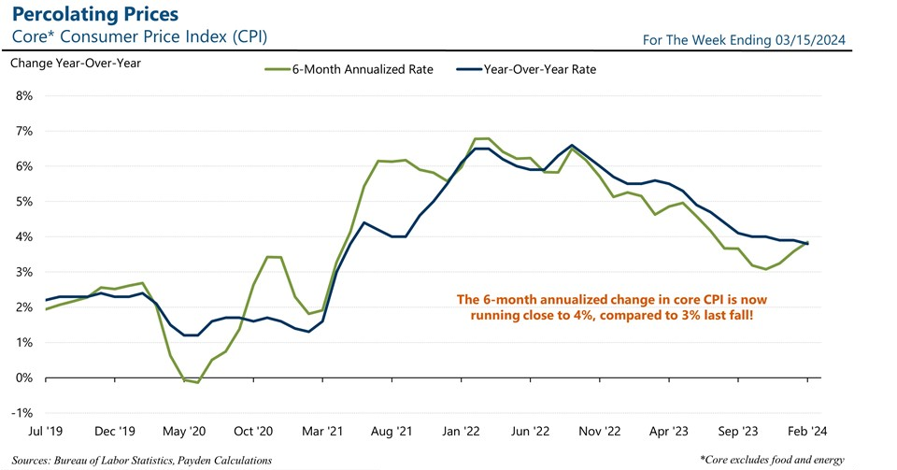

Slide 5
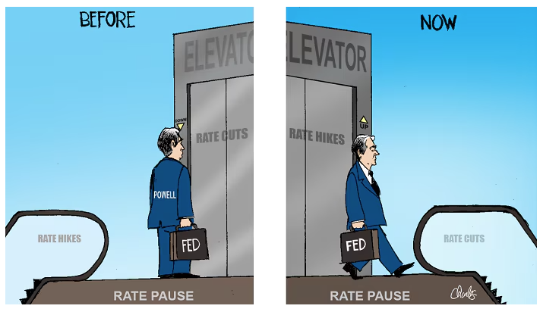
It’s all about the Fed’s pace, pause, & pivot

Slide 6
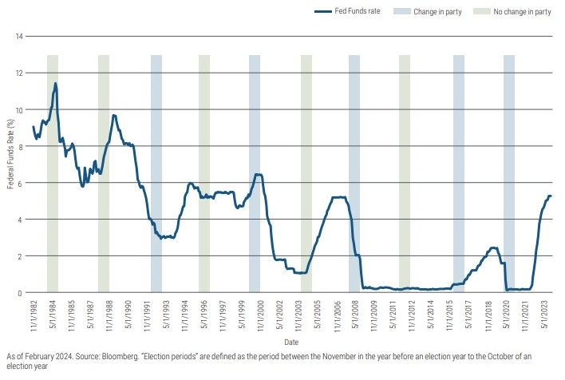
Will the Fed adjust rates in an election year?

Slide 7
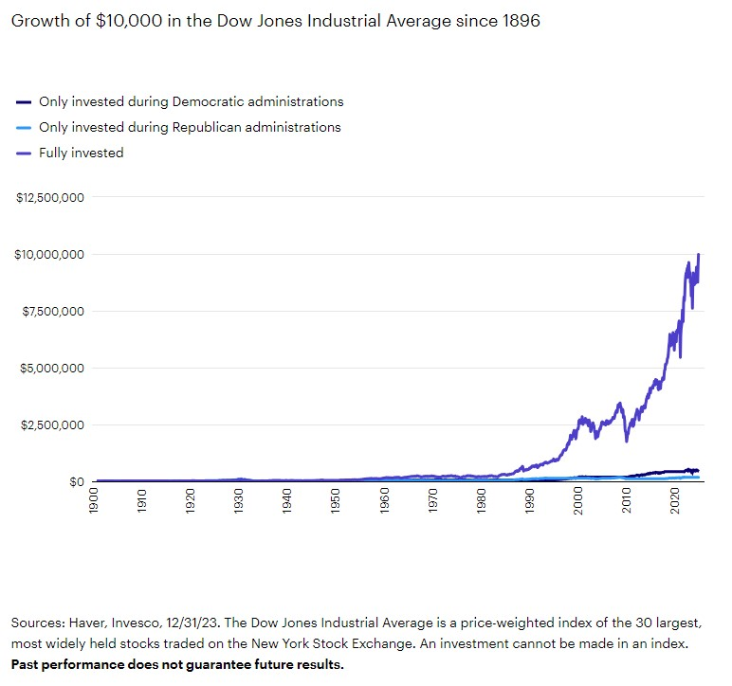
Stay invested, regardless of your political views

Slide 9
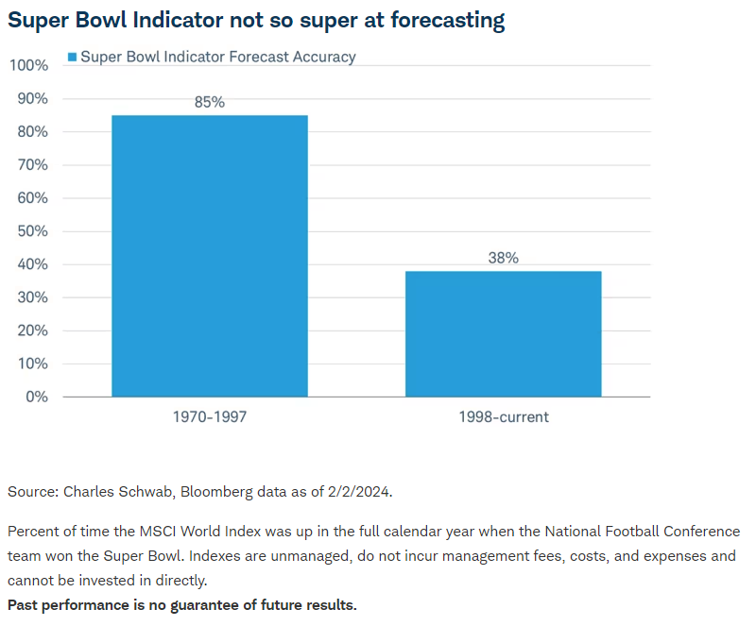

Slide 10
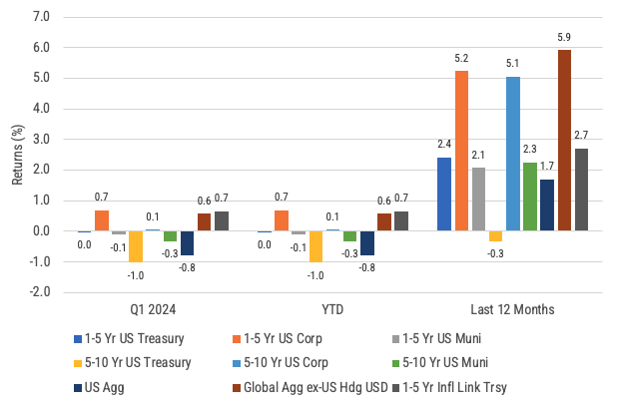
Global bond returns
Source: Morningstar, Bloomberg and ICE BofA ML benchmarks shown. Past performance is not indicative of future results.

Slide 11
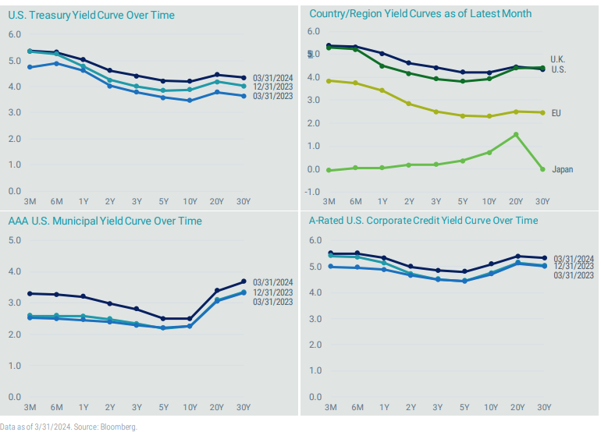
Stories from global yield curves

Slide 12
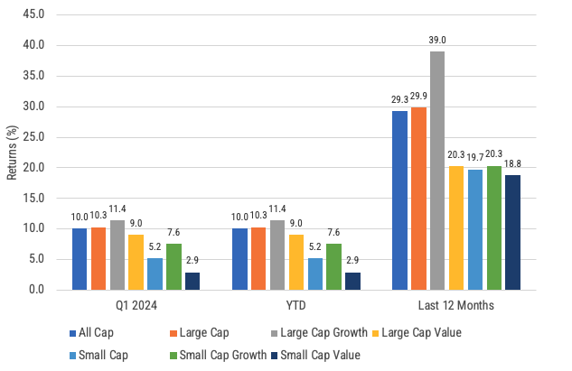
US stock returns by size and style
Source: Morningstar, Russell benchmarks shown. Past performance is not indicative of future results.

Slide 13
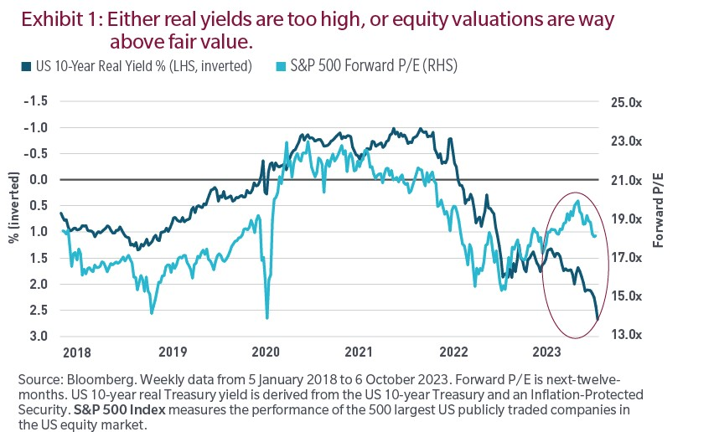

Slide 14
Company | Ticker | 2023 Return | Q1 2024 Return
Apple | AAPL | 48.9% | -10.8%
Microsoft | MSFT | 58.0% | 12.1%
Alphabet (Google) | GOOGL | 58.3% | 8.1%
Amazon | AMZN | 80.9% | 18.7%
NVIDIA | NVDA | 239.0% | 82.5%
Meta | META | 194.1% | 37.3%
Tesla | TSLA | 101.7% | -29.3%
The Magnificent 7: 2023 vs. 1Q 2024
Source: Morningstar, Factset, Standard and Poors, JP Morgan Asset Management. Past performance is no guarantee of future results.

Slide 15
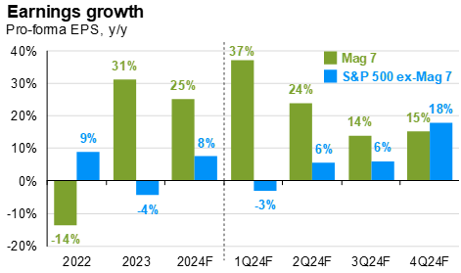
Broadening earnings growth
Source: FactSet, Standard & Poor’s, J.P. Morgan Asset Management. *Magnificent 7 includes AAPL, AMZN, GOOG, GOOGL, META, MSFT, NVDA and TSLA. Earnings estimates for 2024 are forecasts based on consensus analyst expectations. Guide to the Markets – U.S. Data are as of March 31, 2024.
‹#›

Slide 16
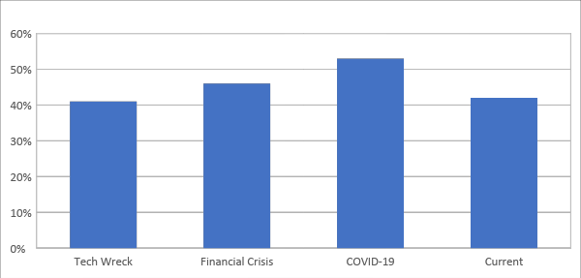
Profitability matters
Source: Compustat, FactSet, FTSE Russell, NBER, J.P. Morgan Asset Management. Data for the percent of unprofitable companies in each index are from the following quarters: Tech bubble = 4Q01, Financial crisis = 4Q08, COVID-19 = 1Q20 and current = 4Q23. Guide to the Markets – U.S. Data are as of March 31, 2024.

Slide 17
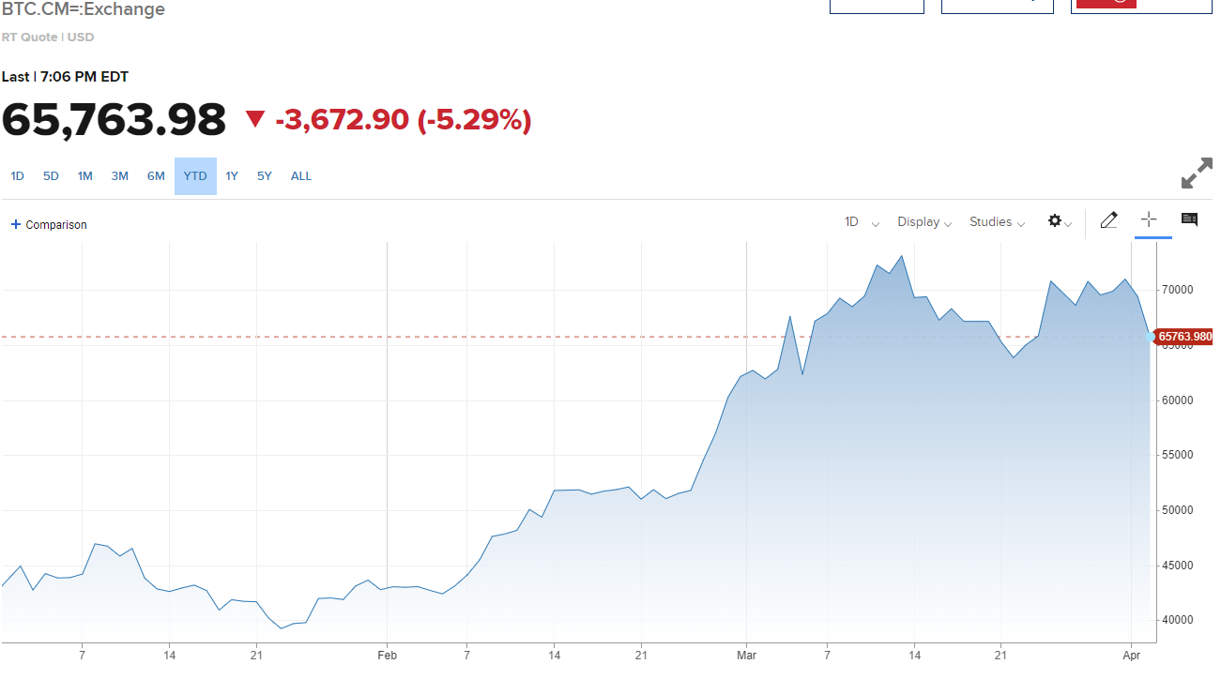
Bitcoin and FOMO

Slide 18
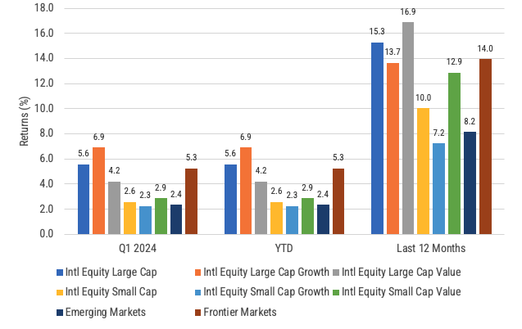
International developed, emerging and frontier stock returns
Source: Morningstar, MSCI benchmark shown. Past performance is not indicative of future results.

Slide 19
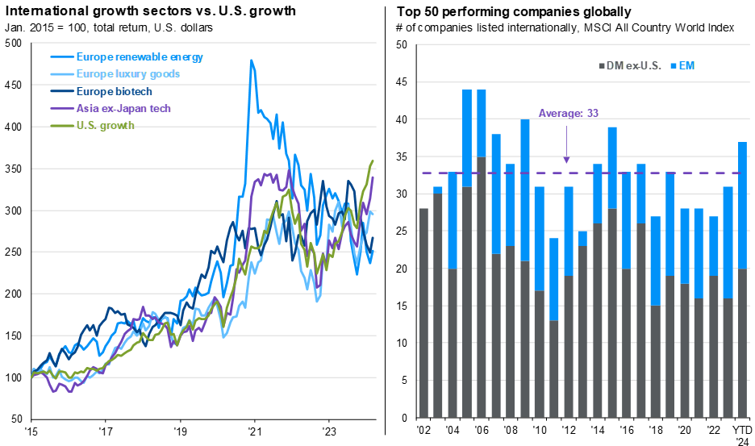
The US doesn’t have a monopoly on growth
Source: FactSet, MSCI, J.P. Morgan Asset Management. (Left) Bloomberg, Russell, Societe Generale. Asia tech ex-Japan: MSCI AC Asia ex-Japan Information Technology Index, European Luxury Goods: MSCI Europe Textiles Apparel and Luxury Goods Index, U.S. Growth: Russell 1000 Growth Index, European renewables: Societe Generale European Renewable Energy Index, Europe biotech: MSCI Europe Biotechnology Index. (Right) Graph was made by ranking all the companies in the MSCI All Country World Index by performance on a yearly basis and determining the top 50 performers using their total return in USD. Companies are listed in no particular order. Excluded companies whose market capitalization does not make up at least 0.01% of the MSCI All Country World Index in the year listed. Guide to the Markets – U.S. Data are as of March 31, 2024.

Slide 20
Dollar strength is good for US consumers but bad for owners of non-US investments
Source: Wall Street Journal as January 2, 2024. Past performance is not indicative of future results.

Slide 21
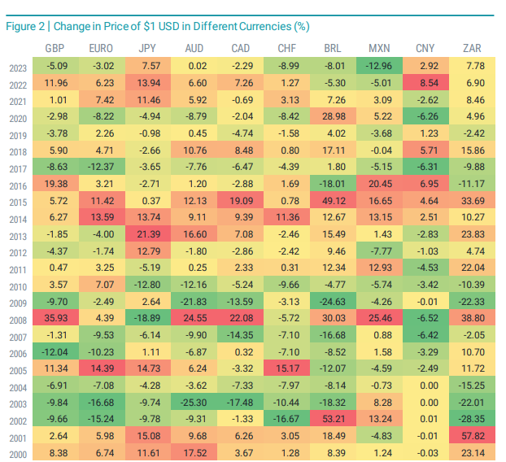
Digging deeper into the impact of currencies
Source: Avantis. Data from 1/1/2000 - 12/31/2023. Source: Bloomberg. GBP = British pound sterling. JPY = Japanese yen. AUD = Australian dollar. CAD = Canadian dollar. CHF = Swiss franc. BRL = Brazilian real. MXN = Mexican peso. CNY = Chinese yuan. ZAR = South African rand. Past performance is no guarantee of future results.

Slide 22
Maintain your focus on what really matters
Financial planning is a process, not an endpoint
Concentrate on long-term goals and objectives
Focus on reaching goals, not on beating benchmarks
Maintain a disciplined approach, in good and bad markets
Invest broadly and globally; asset allocation is key
Reduce investment and tax costs where possible
Rebalance as necessary

Slide 23
Questions?

Slide 24
Disclosures
This information is not intended to be used as the primary basis for investment decisions, nor should it be construed as advice designed to meet the particular needs of an individual investor. Investing in mutual funds, ETFs, and other equity and debt securities involves risk, including loss of principal. An investor should consider a portfolio’s investment objectives, risks, and expenses carefully before investing. Please read any applicable funds’ prospectus carefully before investing. Investors cannot invest directly in an index. Indexes are unmanaged and reflect reinvested dividends and/or distributions, but do not reflect sales charges, commissions, expenses or taxes.
XYPN Invest constructs and manages investment models (“Model Portfolios”) through a technology solution. The Model Portfolios can be used by independent registered investment advisers (“RIAs”) that are members of XYPN, but not affiliated with the XYPN Invest. XYPN Invest manages its Model Portfolios on a discretionary basis primarily by allocating assets among various mutual funds and exchange-traded funds (“ETFs”). XYPN Invest may also allocate assets in individual debt and equity securities. While XYPN Invest will select mutual funds and ETFs for the Model Portfolios, provide guidance and information about the Model Portfolios to RIAs, RIAs are responsible for choosing the specific model and allocation for each of their Clients.

